Slide 1
Deep Learning for Beginners
From Basics to Production with NumPy and TensorFlow

Slide 2
Section IV Derivatives and Gradient Descent

Slide 3

Gradient Descent
Gradient descent is an optimization technique that uses derivatives and iterations to minimize/maximize a set of parameters against an objective.
We can use it to solve a wide array of problems, ranging from a simple linear regression to a deep learning model with millions of parameters.
We will start with a few basics and then work up from there, including basic Calculus and a simple linear regression.

Slide 4
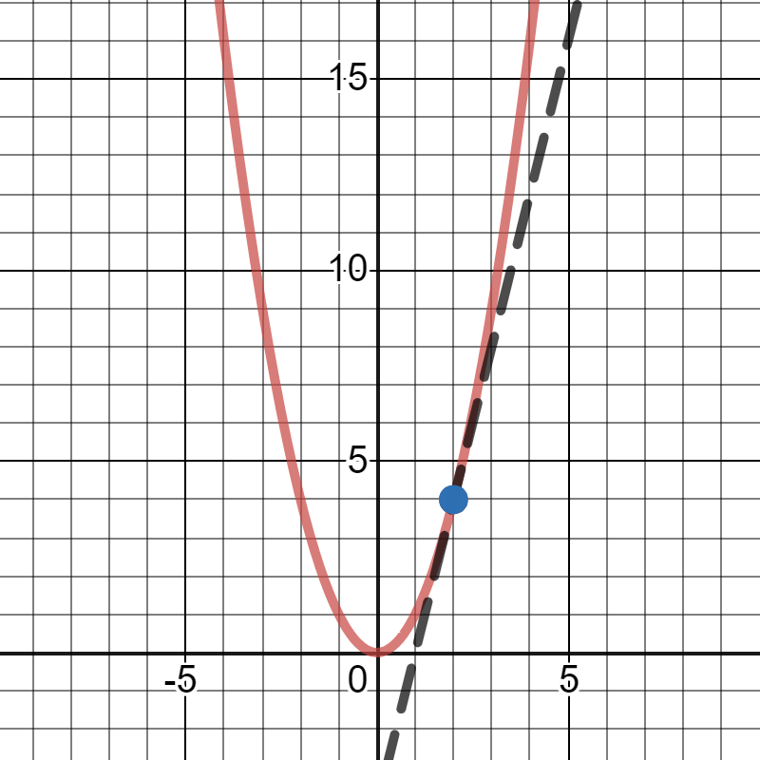
Derivatives
A derivative tells the slope of a function, and it is useful to measure the rate of change at any point in a function.
Why do we care about derivatives? They are often used in machine learning, deep learning and other mathematical algorithms, especially with gradient descent.
When the slope is 0, that means we are at the minimum or maximum of an output variable.
This concept will be useful for performing gradient descent on neural networks.

Slide 5
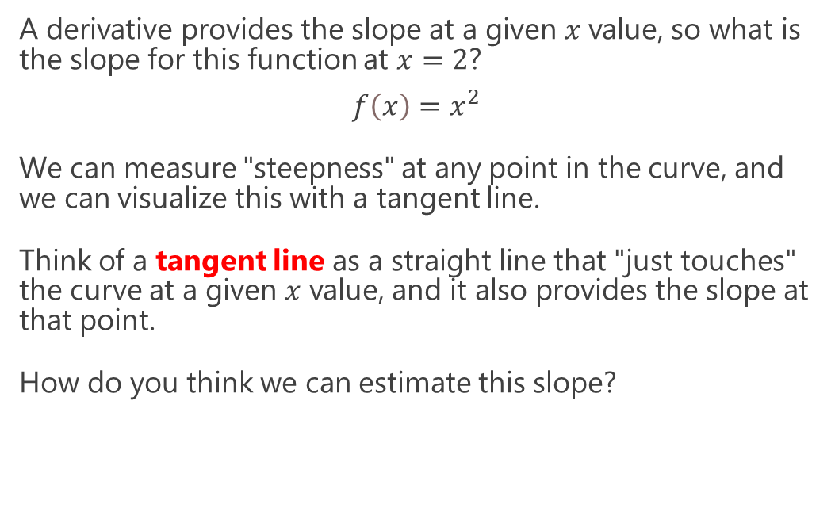
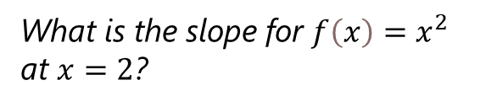
Derivatives – Measuring “Steepness”
A derivative provides the slope at a given $x$value, so what is the slope for this function at $x=2$?
$$f\left(x\right)=x^{2}$$
We can measure "steepness" at any point in the curve, and we can visualize this with a tangent line.
Think of a tangent line as a straight line that "just touches" the curve at a given $x$ value, and it also provides the slope at that point.
How do you think we can estimate this slope?
What is the slope for $f\left(x\right)=x^{2}$ at $x=2$?

Slide 6
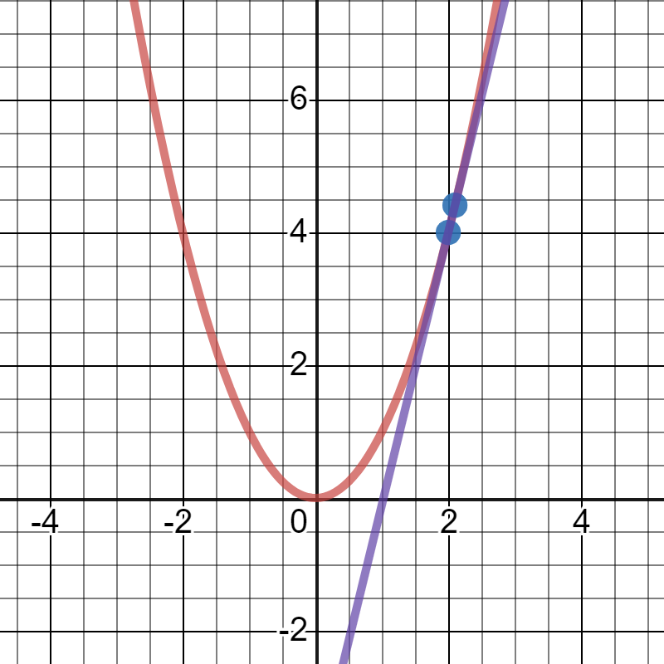
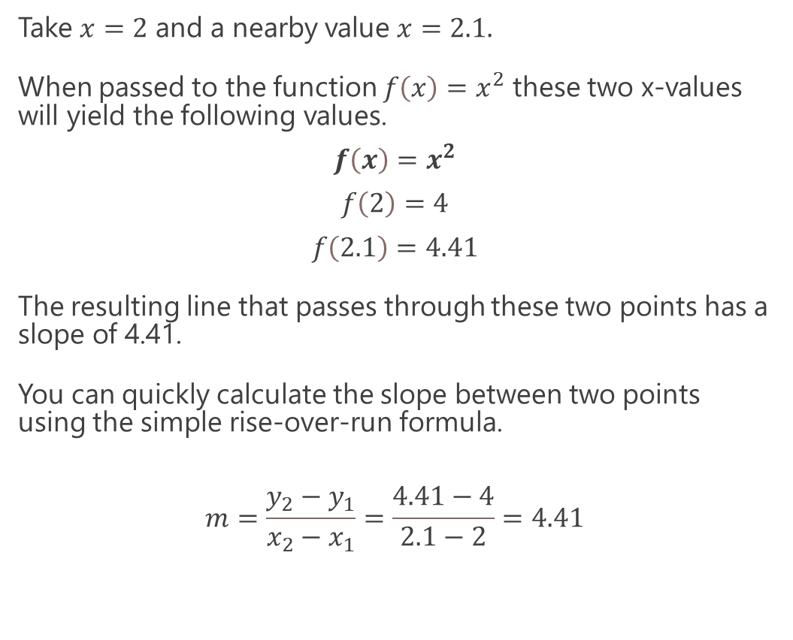
Derivatives – Measuring “Steepness”
Take $x=2$ and a nearby value $x=2.1.$
When passed to the function $f\left(x\right)=x^{2}$ these two x-values will yield the following values.
$$f\left(x\right)=x^{2}$$
$$f\left(2\right)=4$$
$$f\left(2.1\right)=4.41$$
The resulting line that passes through these two points has a slope of 4.41.
You can quickly calculate the slope between two points using the simple rise-over-run formula.
$$m=\frac{y_{2}−y_{1}}{x_{2}−x_{1}}=\frac{4.41−4}{2.1−2}=4.41$$
We can estimate slope at a given point by drawing a line through a close neighboring point.

Slide 7
Derivatives – Measuring “Steepness”
Here is how we implement this slope estimator in Python, where derivative_x() returns the slope and my_function() is the parabola function.
We add .00001 to our x-value to get a really close neighboring x-value.
def derivative_x(f, x, step_size): m = (f(x + step_size) - f(x)) / ((x + step_size) - x) return m def my_function(x): return x ** 2 slope_at_2 = derivative_x(my_function, 2, .00001) print(slope_at_2) # prints 4.000010000000827
We can estimate slope at a given point by drawing a line through a close neighboring point.

Slide 8
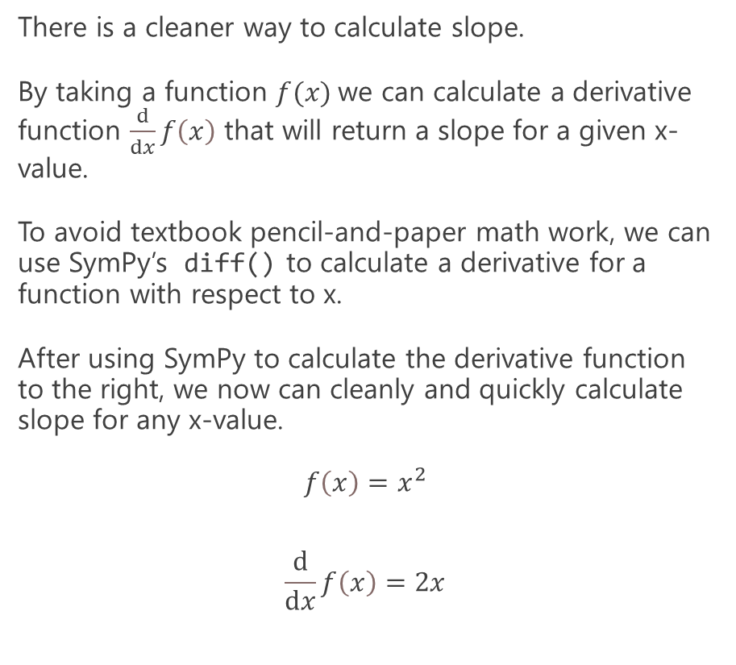
Derivatives – Using SymPy
There is a cleaner way to calculate slope.
By taking a function $f(x)$we can calculate a derivative function $\frac{ⅆ}{ⅆx}f\left(x\right)$ that will return a slope for a given x-value.
To avoid textbook pencil-and-paper math work, we can use SymPy’s diff() to calculate a derivative for a function with respect to x.
After using SymPy to calculate the derivative function to the right, we now can cleanly and quickly calculate slope for any x-value.
$$f\left(x\right)=x^{2}$$
$$\frac{ⅆ}{ⅆx}f\left(x\right)=2x$$
from sympy import * # Declare 'x' to SymPy x = symbols('x') # Now just use Python syntax to declare function f = x**2 # Calculate the derivative of the function dx_f = diff(f) print(dx_f) # prints 2*x

Slide 9
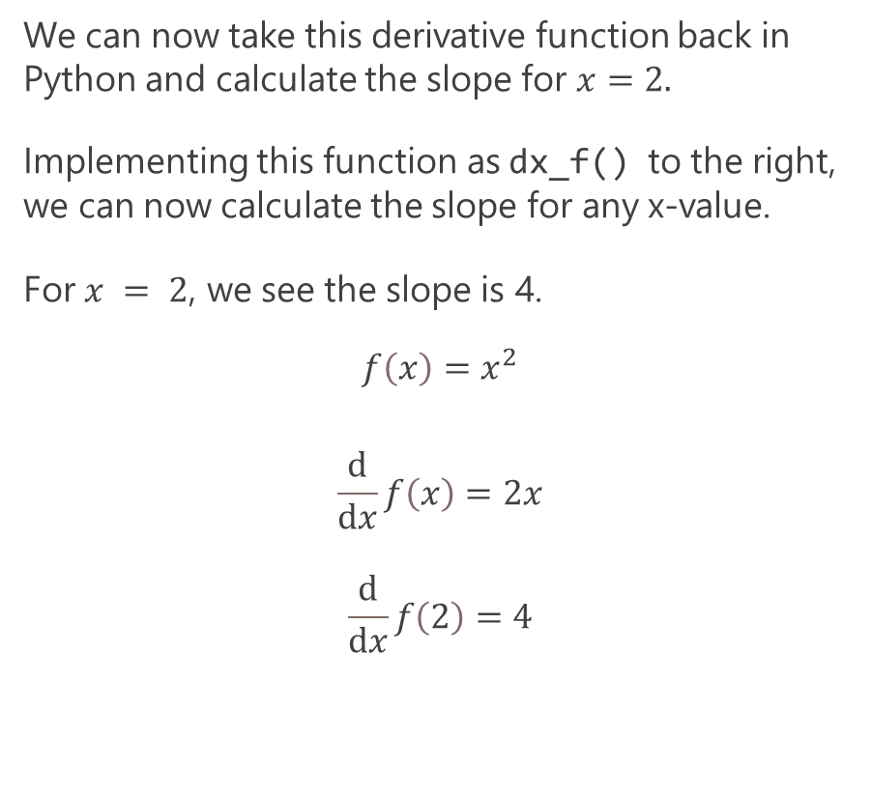
Derivatives – Using SymPy
We can now take this derivative function back in Python and calculate the slope for $x=2.$
Implementing this function as dx_f() to the right, we can now calculate the slope for any x-value.
For $x = 2$, we see the slope is 4.
$$f\left(x\right)=x^{2}$$
$$\frac{ⅆ}{ⅆx}f\left(x\right)=2x$$
$$\frac{ⅆ}{ⅆx}f\left(2\right)=4$$
# Using Plain Python def f(x): return x ** 2 def dx_f(x): return 2 * x slope_at_2 = dx_f(2.0) print(slope_at_2) # prints 4.0

Slide 10
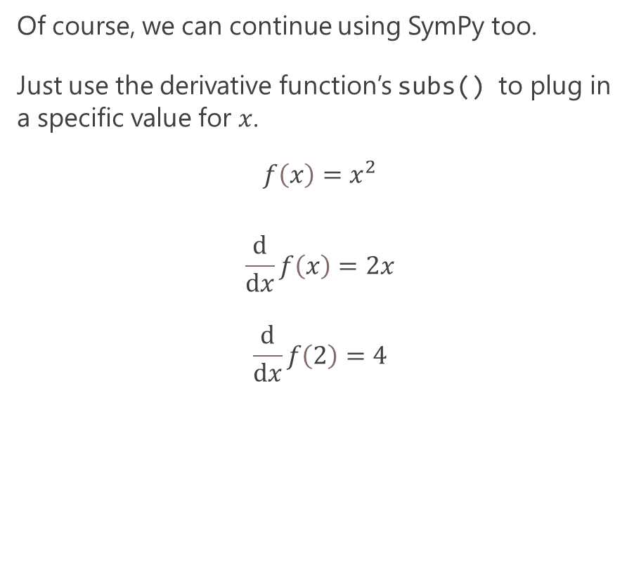
Derivatives – Using SymPy
Of course, we can continue using SymPy too.
Just use the derivative function’s subs() to plug in a specific value for $x$.
$$f\left(x\right)=x^{2}$$
$$\frac{ⅆ}{ⅆx}f\left(x\right)=2x$$
$$\frac{ⅆ}{ⅆx}f\left(2\right)=4$$
# Continue Using SymPy from sympy import * # Declare 'x' to SymPy x = symbols('x') # Now just use Python syntax
# to declare function f = x**2 # Calculate the derivative of the function dx_f = diff(f) # Calculate the slope at x = 2 print(dx_f.subs(x,2)) # prints 4

Slide 11
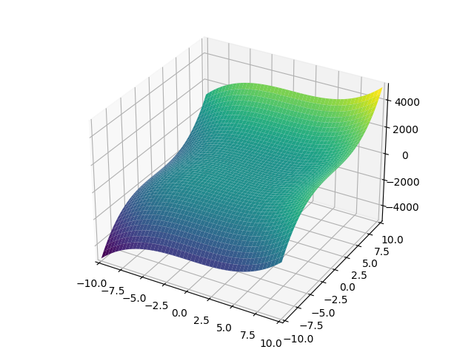
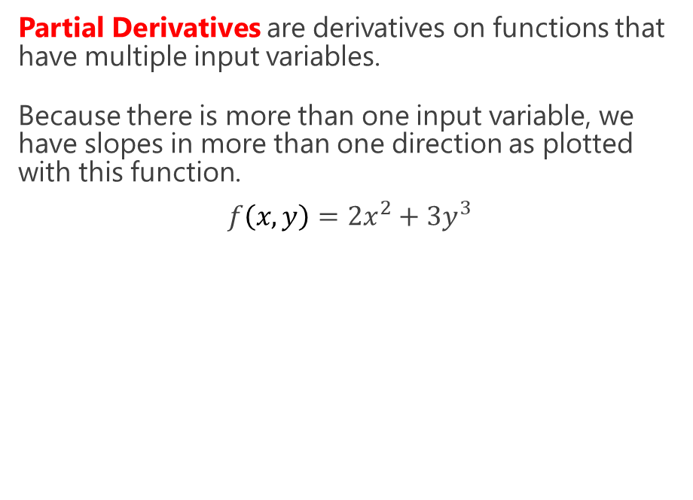
Partial Derivatives
Partial Derivatives are derivatives on functions that have multiple input variables.
Because there is more than one input variable, we have slopes in more than one direction as plotted with this function.
$$f\left(x,y\right)=2x^{2}+3y^{3}$$
from sympy import * from sympy.plotting import plot3d # Declare x and y to SymPy x,y = symbols('x y') # Now just use Python syntax to declare function f = 2*x**3 + 3*y**3 # plot the function plot3d(f)

Slide 12
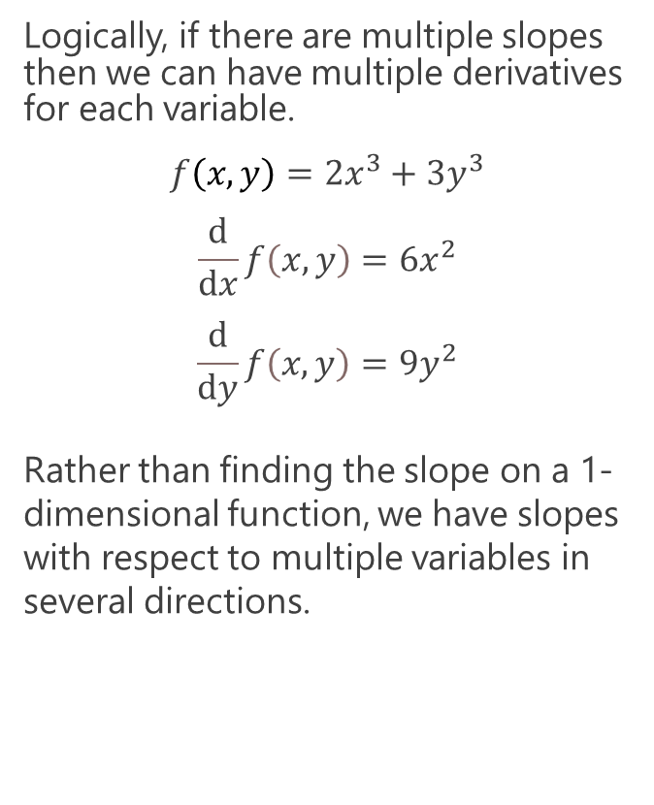
Partial Derivatives
Logically, if there are multiple slopes then we can have multiple derivatives for each variable.
$$f\left(x,y\right)=2x^{3}+3y^{3}$$
$$\frac{ⅆ}{ⅆx}f\left(x,y\right)=6x^{2}$$
$$\frac{ⅆ}{ⅆy}f\left(x,y\right)=9y^{2}$$
Rather than finding the slope on a 1-dimensional function, we have slopes with respect to multiple variables in several directions.
from sympy import * from sympy.plotting import plot3d # Declare x and y to SymPy x,y = symbols('x y') # Now just use Python syntax to declare function f = 2*x**3 + 3*y**3 # Calculate the partial derivatives for x and y dx_f = diff(f, x) dy_f = diff(f, y) print(dx_f) # prints 6*x**2 print(dy_f) # prints 9*y**2 # plot the function plot3d(f)

Slide 13
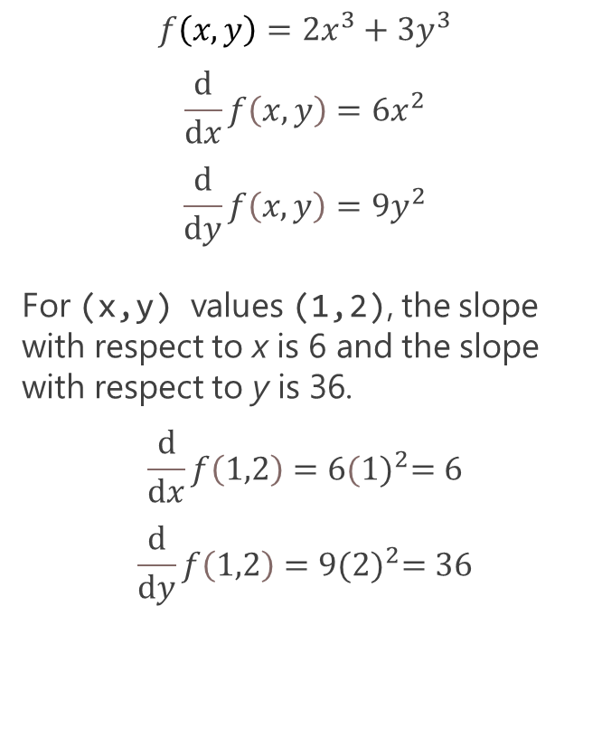
Partial Derivatives
$$f\left(x,y\right)=2x^{3}+3y^{3}$$
$$\frac{ⅆ}{ⅆx}f\left(x,y\right)=6x^{2}$$
$$\frac{ⅆ}{ⅆy}f\left(x,y\right)=9y^{2}$$
For (x,y) values (1,2), the slope with respect to x is 6 and the slope with respect to y is 36.
$$\frac{ⅆ}{ⅆx}f\left(1,2\right)=6{(1)}^{2}=6$$
$$\frac{ⅆ}{ⅆy}f\left(1,2\right)=9{(2)}^{2}=36$$
from sympy import * from sympy.plotting import plot3d # Declare x and y to SymPy x,y = symbols('x y') # Now just use Python syntax to declare function f = 2*x**3 + 3*y**3 # Calculate the partial derivatives for x and y dx_f = diff(f, x) dy_f = diff(f, y) print(dx_f) # prints 6*x**2 print(dy_f) # prints 9*y**2 # plot the function plot3d(f)

Slide 14
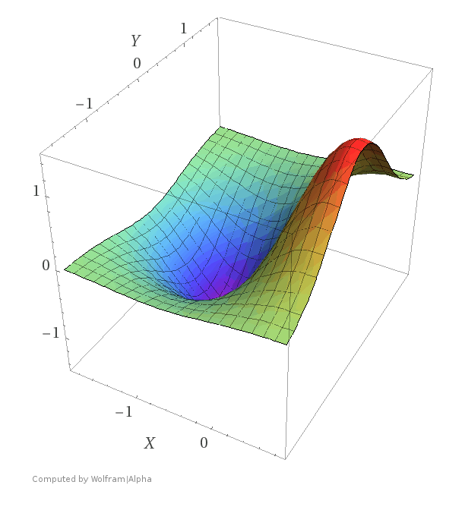
Gradient Descent - Making Calculus Useful
Gradient descent is a continuous/nonlinear optimization method that uses Calculus derivatives to find a local minimum/maximum.
This methodology has become highly popular due to the need to optimize thousands and even millions of machine learning variables, like neural networks and their node weight values.

Slide 15
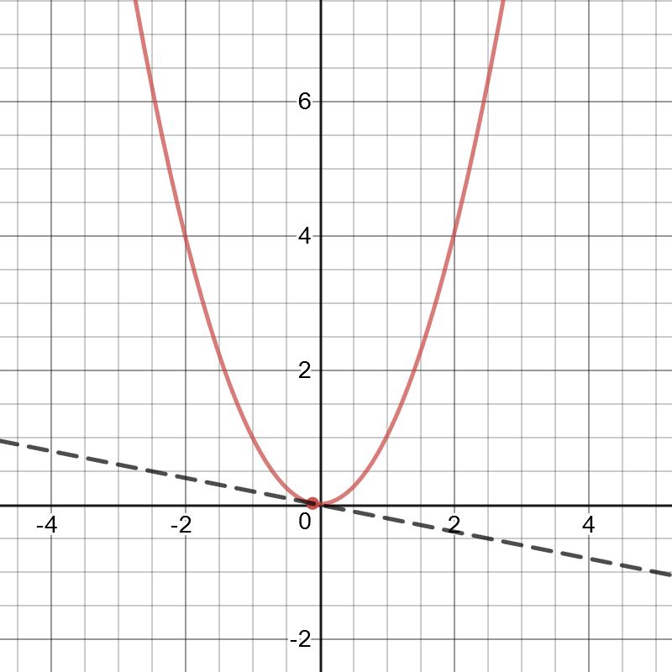
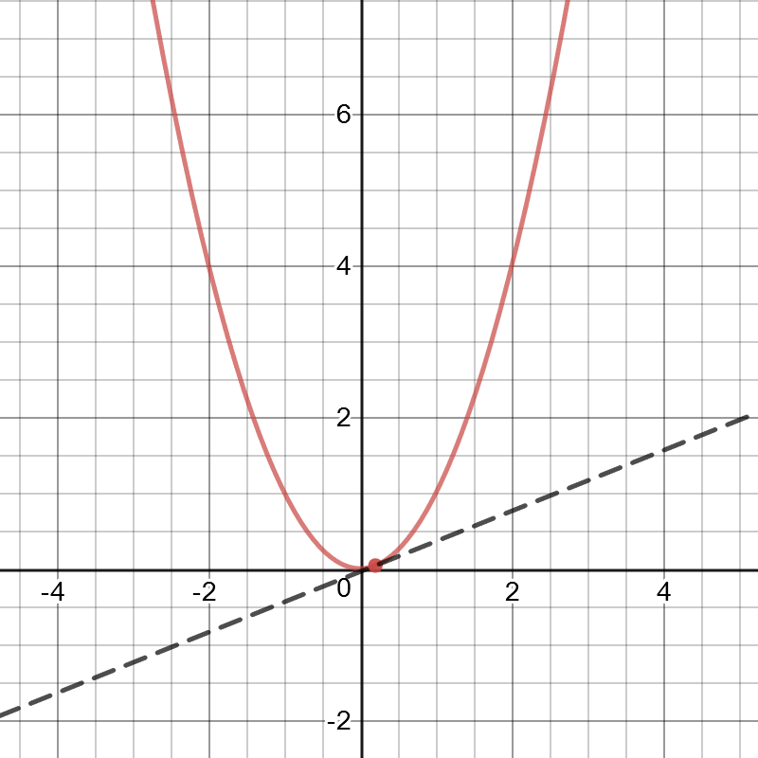
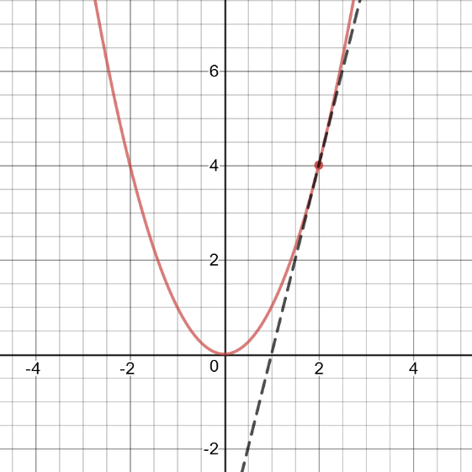
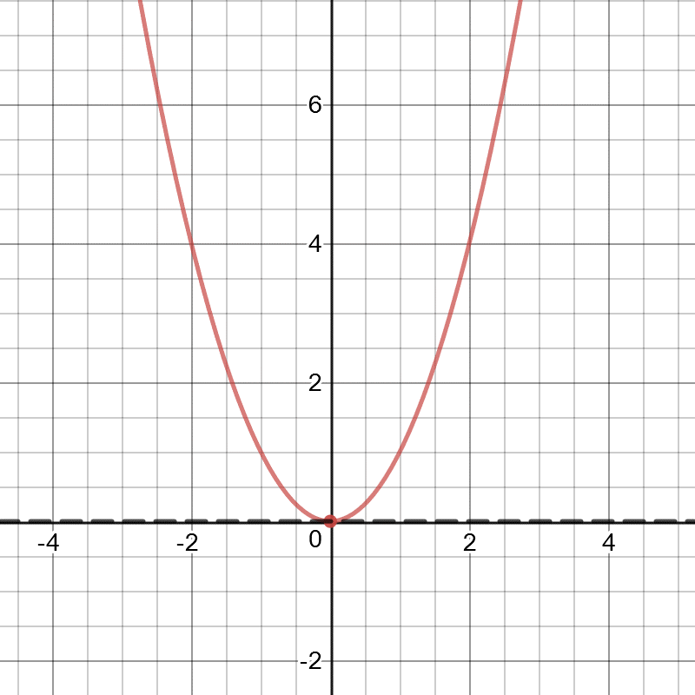
The Essence of Gradient Descent
For a given function, notice how when the slope is zero, we are at a local minimum/maximum!
As the slope gets closer to zero, the closer we are to the local minimum /maximum.
Oppositely, the larger/steeper the slope the farther we are from the local minimum.
m =-0.4
m = 0
m = 0.4
m = 4.0
https://www.desmos.com/calculator/ruvtlp9zk6

Slide 16
The Essence of Gradient Descent
Starting our search in a random or arbitrary location, we want it to step towards the local minimum.
The slope is like a compass providing direction to the local minimum/maximum. We step in directions that make the slope smaller, leading it to 0.
To make this process quicker, we can take bigger steps for bigger slopes, and smaller steps for smaller slopes.
This is the basic idea behind gradient descent.
m =-0.4
m = 0
m = 0.4
m = 4.0
https://www.desmos.com/calculator/ruvtlp9zk6

Slide 17
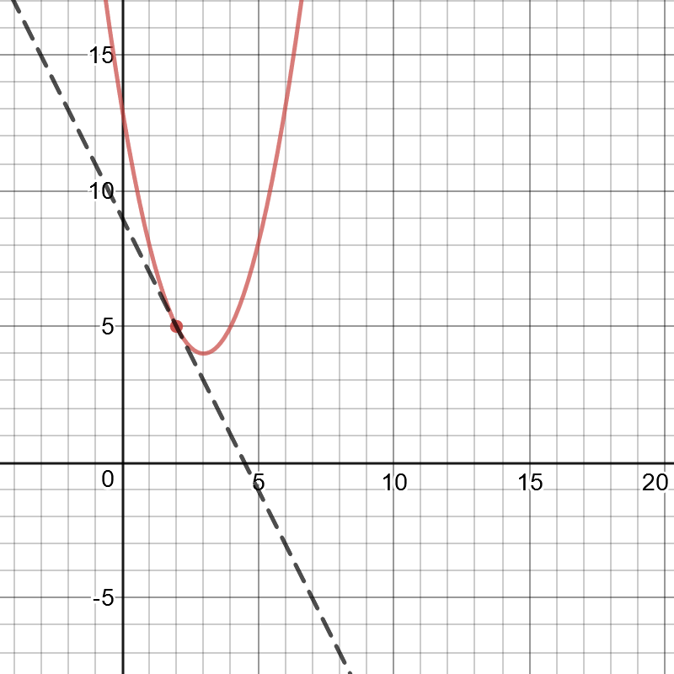
Gradient Descent with One Variable
Let’s perform gradient descent to find the local minimum of this function.

Slide 18
Gradient Descent with One Variable
Let’s walk this through:
We declare our function and derivative of our function.
import random def f(x): return (x - 3) ** 2 + 4 def dx_f(x): return 2*(x - 3) L = 0.001 # The learning rate epochs = 100000 # The number of iterations to perform gradient descent x = random.randint(-15,15) # start at a random x for i in range(epochs): d_x = dx_f(x) # get slope x = x - L * d_x # update x by subtracting the (learning rate) * (slope) print(x, f(x)) # prints 2.999999999999889 4.0

Slide 19
Gradient Descent with One Variable
Let’s walk this through:
L is our learning rate, which scales how small our steps are. Smaller value means smaller steps. Having this too small can make this slow and require more iterations. Having it too large will cause it to keep stepping over the local minimum.
Epochs is a fancy name for number of iterations. You need enough so the search doesn’t stop prematurely.
import random def f(x): return (x - 3) ** 2 + 4 def dx_f(x): return 2*(x - 3) L = 0.001 # The learning rate epochs = 100000 # The number of iterations to perform gradient descent x = random.randint(-15,15) # start at a random x for i in range(epochs): d_x = dx_f(x) # get slope x = x - L * d_x # update x by subtracting the (learning rate) * (slope) print(x, f(x)) # prints 2.999999999999889 4.0

Slide 20
Gradient Descent with One Variable
Let’s walk this through:
We start x at a random or arbitrary location. If there are several local minimums, this could have an impact on our answer.
Fortunately, this problem only has one local minimum.
import random def f(x): return (x - 3) ** 2 + 4 def dx_f(x): return 2*(x - 3) L = 0.001 # The learning rate epochs = 100000 # The number of iterations to perform gradient descent x = random.randint(-15,15) # start at a random x for i in range(epochs): d_x = dx_f(x) # get slope x = x - L * d_x # update x by subtracting the (learning rate) * (slope) print(x, f(x)) # prints 2.999999999999889 4.0

Slide 21
Gradient Descent with One Variable
Let’s walk this through:
We use the derivative to calculate the slope and figure out which direction to step x towards and by how much.
This means repeatedly subtracting the (slope * learning rate) from x to progress towards the minimum.
import random def f(x): return (x - 3) ** 2 + 4 def dx_f(x): return 2*(x - 3) L = 0.001 # The learning rate epochs = 100000 # The number of iterations to perform gradient descent x = random.randint(-15,15) # start at a random x for i in range(epochs): d_x = dx_f(x) # get slope x = x - L * d_x # update x by subtracting the (learning rate) * (slope) print(x, f(x)) # prints 2.999999999999889 4.0

Slide 22
Gradient Descent – A Metaphor
Here’s another way to think of gradient descent.
Imagine you are in the mountains at night with a flashlight and want to get to the lowest point.
You can only see immediately around you, but you step in directions that slope downwards.
You take bigger steps for bigger slopes, and smaller steps for smaller slopes.
Ultimately, you get to the bottom!

Slide 23
Gradient Descent – A Metaphor
Metaphorically, that flashlight is your derivative function that tells you the slope around you.
The steps are a fraction of the slope (the learning rate), but having that fraction too large is like having a giant unable to get to the lowest point.
Having that fraction too small is like having an ant that can find the minimum more precisely, but takes much longer and requires more steps.
You need to find an agreeable step size between the two by choosing the right learning rate.

Slide 24
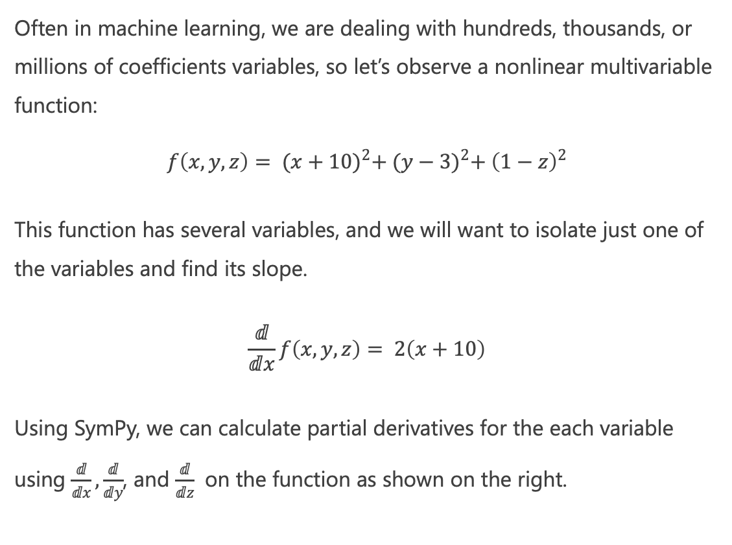
Multivariable Gradient Descent: Partial Derivatives
Often in machine learning, we are dealing with hundreds, thousands, or millions of coefficients variables, so let’s observe a nonlinear multivariable function:
$$f\left(x,y,z\right)= {(x+10)}^{2}+ {(y−3)}^{2}+ {\left(1−z\right)}^{2}$$
This function has several variables, and we will want to isolate just one of the variables and find its slope.
$$\frac{ⅆ}{ⅆx}f\left(x,y,z\right)= 2\left(x+10\right)$$
Using SymPy, we can calculate partial derivatives for the each variable using $\frac{ⅆ}{ⅆx},\frac{ⅆ}{ⅆy}$, and $\frac{ⅆ}{ⅆz}$ on the function as shown on the right.
from sympy import * # Declare x and y to SymPy x,y,z = symbols('x y z') # Now just use Python syntax to declare function f = (x+10)**2 + (y-3)**2 + (1-z)**2 # Calculate the partial derivatives for x and y dx_f = diff(f, x) dy_f = diff(f, y) dz_f = diff(f, z) print(dx_f) # 2*x + 20 print(dy_f) # 2*y - 6 print(dz_f) # 2*z - 2

Slide 25
Multivariable Gradient Descent
We now manage three derivatives and not just one, and use them to adjust the three variables respectively.
Using gradient descent, we roughly minimize (x,y,z) to numbers close to (-10, 3, 1) and closely reach a minimum of 0.
Congrats! You are doing multivariable calculus.
def f(x,y,z):
return (x+10)**2 + (y-3)**2 + (1-z)**2
def dx_f(x):
return 2*x + 20
def dy_f(y):
return 2*y - 6
def dz_f(z):
return 2*z - 2
L = 0.0001 # The learning rate
epochs = 1000000 # The number of iterations to perform gradient descent
x = 0 # we will find the x for the minimum
y = 0 # we will find the y for the minimum
z = 0 # we will find the z for the minimum
for i in range(epochs):
d_x = dx_f(x) # get x slope
d_y = dy_f(y) # get y slope
d_z = dz_f(z) # get z slope
x = x - L * d_x # update x
y = y - L * d_y # update y
z = z - L * d_z # update z
# -9.999999999995559 2.9999999999988898 0.9999999999997224 2.1031154992708616e-23
print(x, y, z, f(x,y,z))

Slide 26
Section V Stochastic Gradient Descent

Slide 27
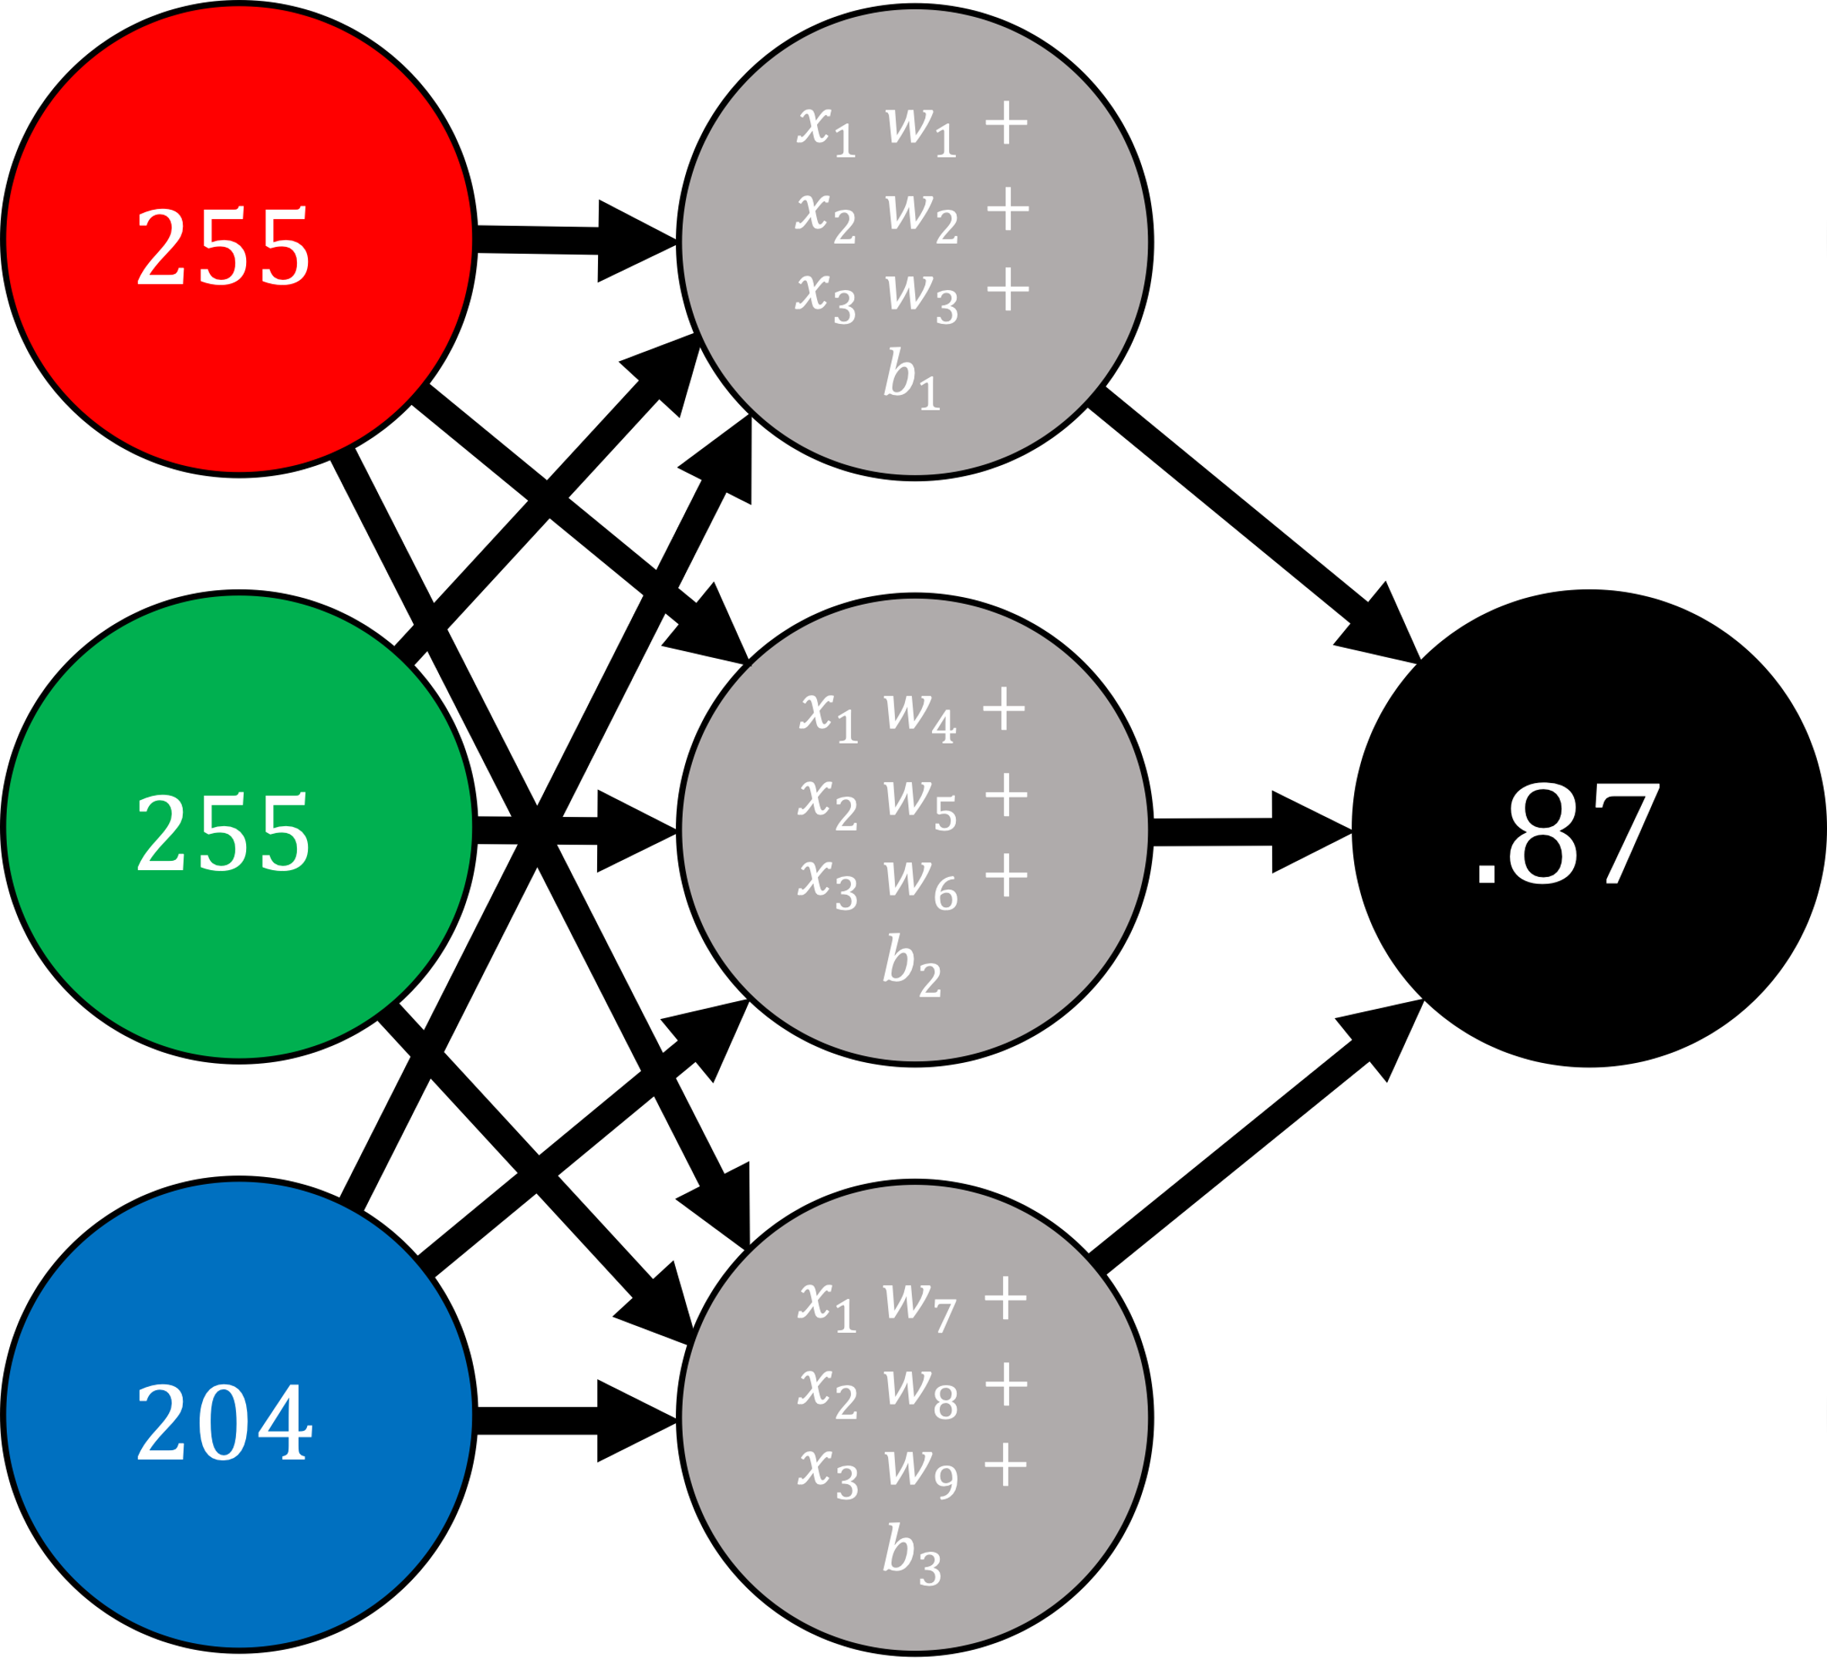
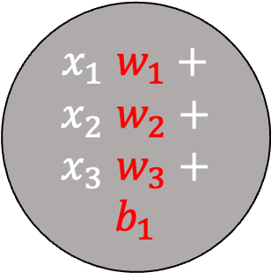
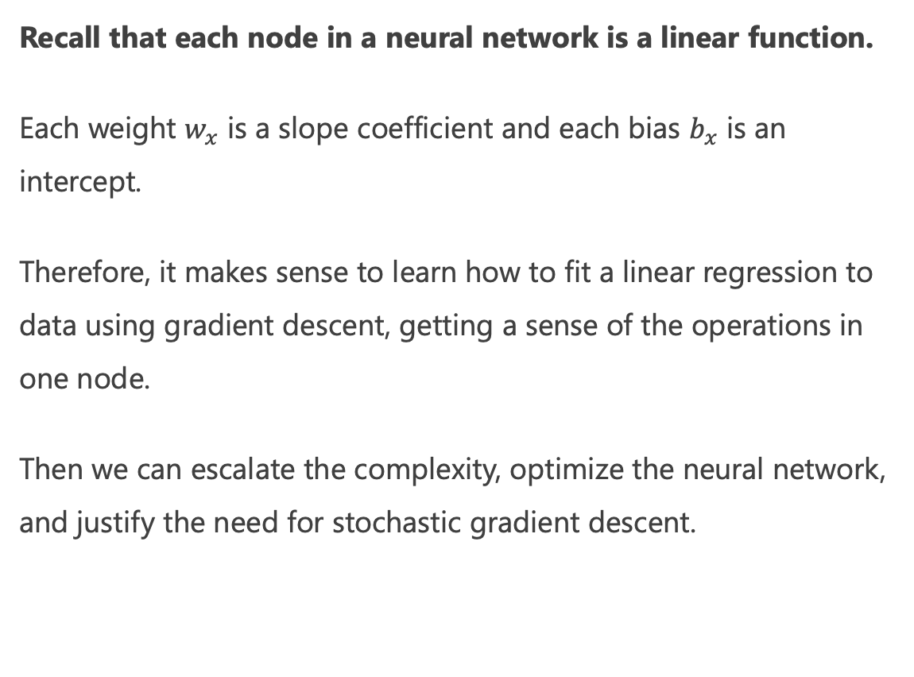
Let’s Walk Before We Run
Recall that each node in a neural network is a linear function.
Each weight $w_{x}$ is a slope coefficient and each bias $b_{x}$ is an intercept.
Therefore, it makes sense to learn how to fit a linear regression to data using gradient descent, getting a sense of the operations in one node.
Then we can escalate the complexity, optimize the neural network, and justify the need for stochastic gradient descent.
$x_{1}$ $w_{1}+x_{2} w_{2}+x_{3} w_{3}+b_{1}$

Slide 28
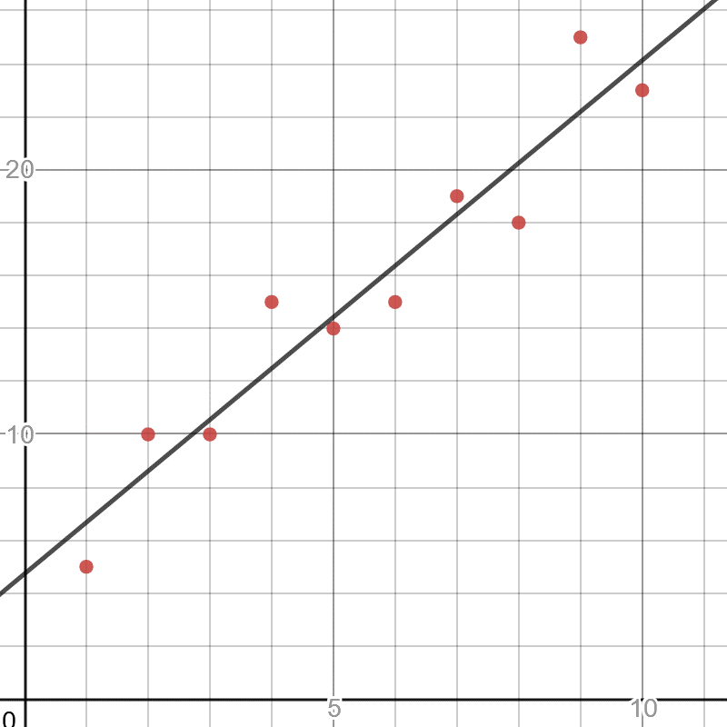
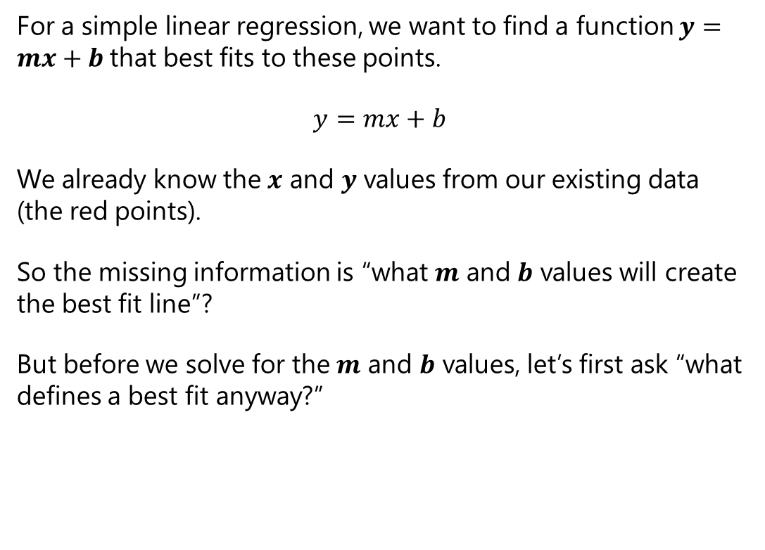
Simple Linear Regression
For a simple linear regression, we want to find a function $y=mx+b$that best fits to these points.
$$y=mx+b$$
We already know the $x$ and $y$ values from our existing data (the red points).
So the missing information is “what $m$ and $b$ values will create the best fit line”?
But before we solve for the $m$ and $b$ values, let’s first ask “what defines a best fit anyway?”
https://www.desmos.com/calculator/fmhotfn3qm

Slide 29

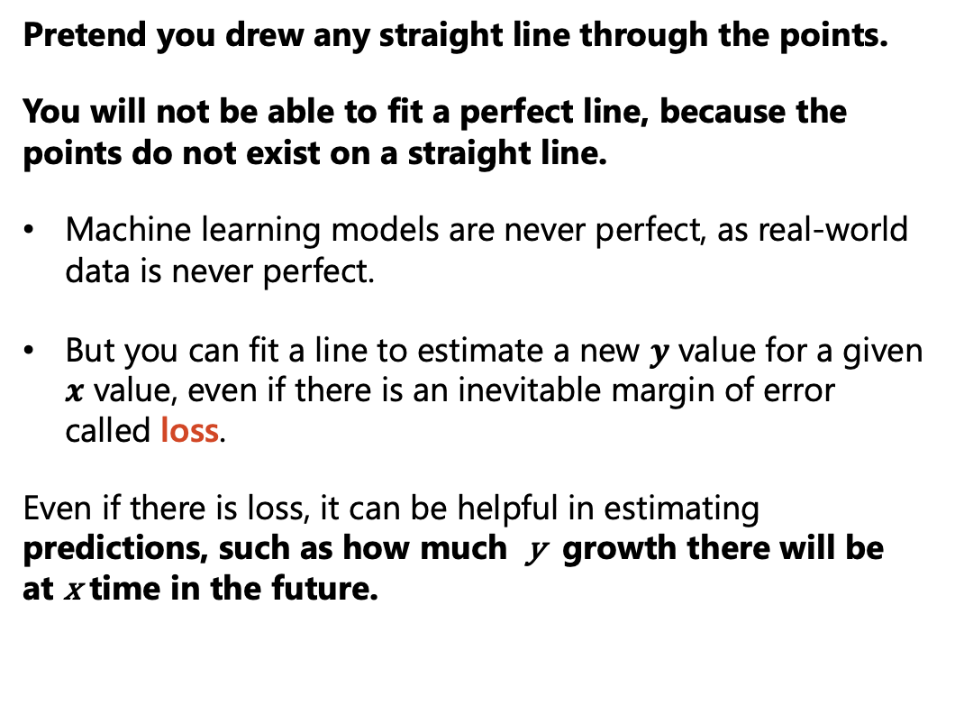
Simple Linear Regression
Pretend you drew any straight line through the points.
You will not be able to fit a perfect line, because the points do not exist on a straight line.
Machine learning models are never perfect, as real-world data is never perfect.
But you can fit a line to estimate a new $y$ value for a given $x$ value, even if there is an inevitable margin of error called loss.
Even if there is loss, it can be helpful in estimating predictions, such as how much y growth there will be at x time in the future.
https://www.desmos.com/calculator/fmhotfn3qm

Slide 30
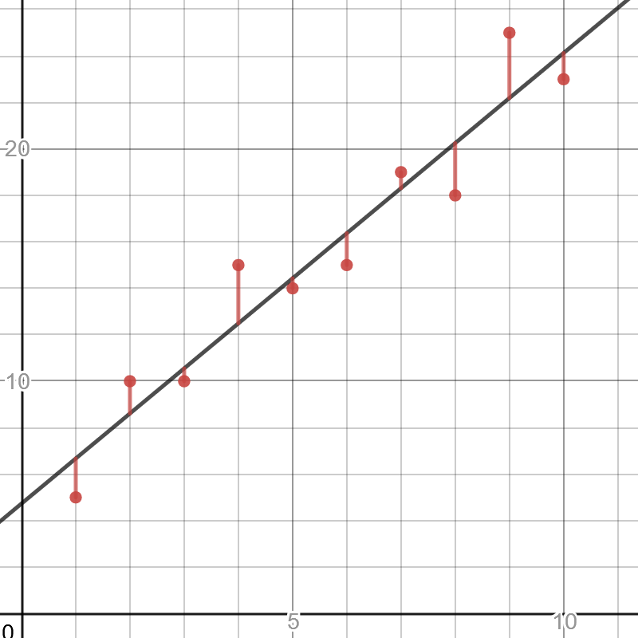
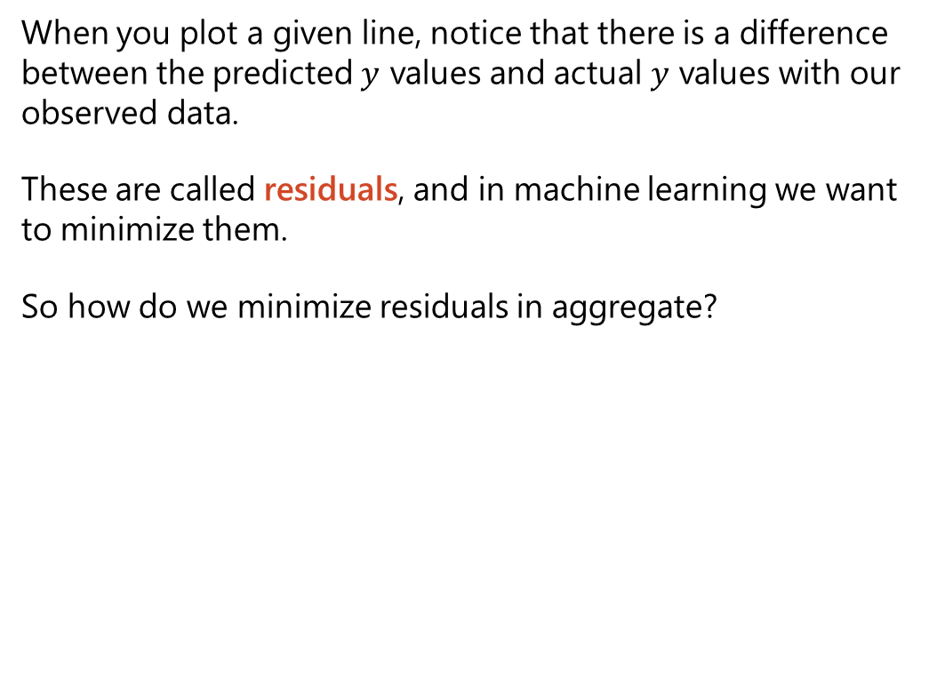
Simple Linear Regression
When you plot a given line, notice that there is a difference between the predicted $y$ values and actual $y$ values with our observed data.
These are called residuals, and in machine learning we want to minimize them.
So how do we minimize residuals in aggregate?
https://www.desmos.com/calculator/fmhotfn3qm

Slide 31
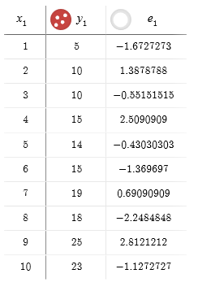
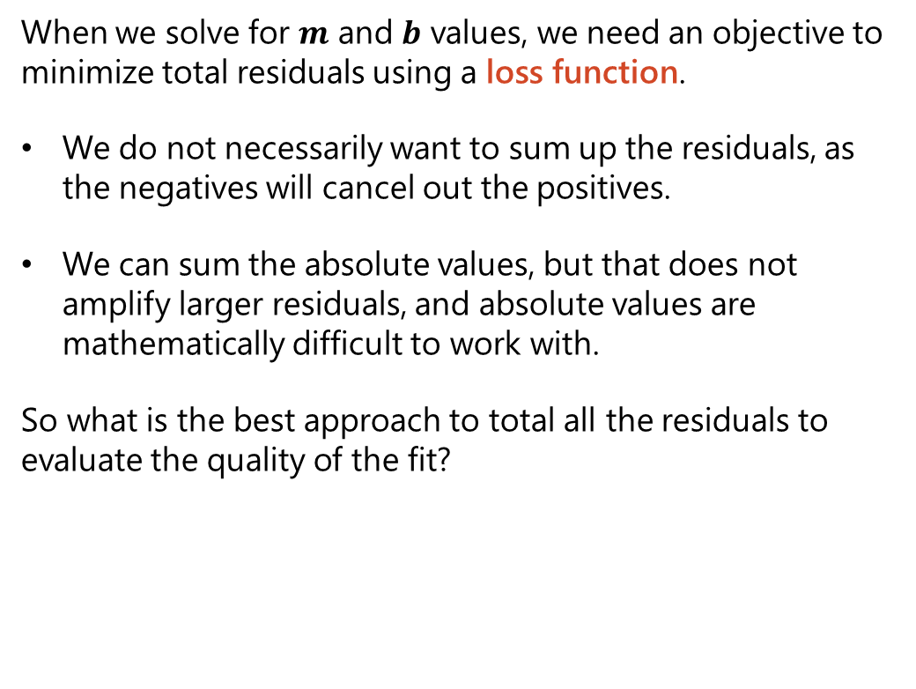
Sum of Least Squares
When we solve for $m$ and $b$ values, we need an objective to minimize total residuals using a loss function.
We do not necessarily want to sum up the residuals, as the negatives will cancel out the positives.
We can sum the absolute values, but that does not amplify larger residuals, and absolute values are mathematically difficult to work with.
So what is the best approach to total all the residuals to evaluate the quality of the fit?

Slide 32
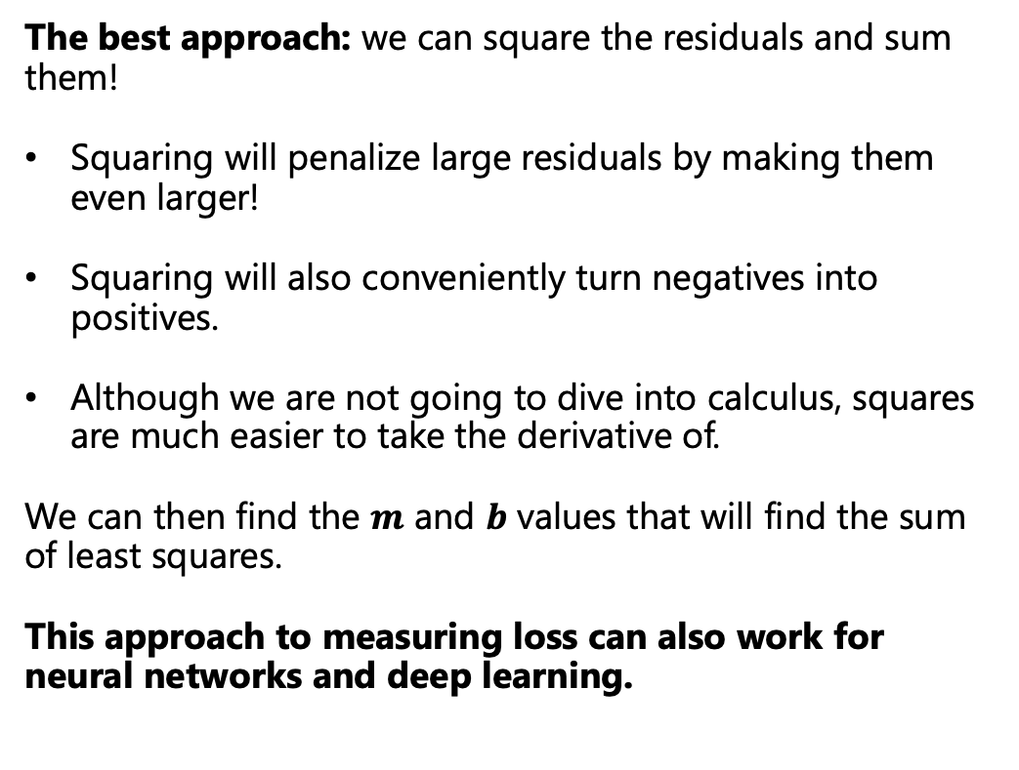
Sum of Least Squares
The best approach: we can square the residuals and sum them!
Squaring will penalize large residuals by making them even larger!
Squaring will also conveniently turn negatives into positives.
Although we are not going to dive into calculus, squares are much easier to take the derivative of.
We can then find the $m$ and $b$ values that will find the sum of least squares.
This approach to measuring loss can also work for neural networks and deep learning.

Slide 33
Calculating Sum of Squares

Slide 34
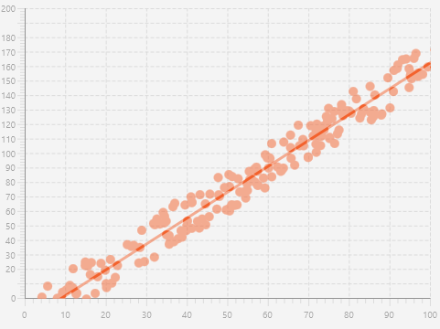
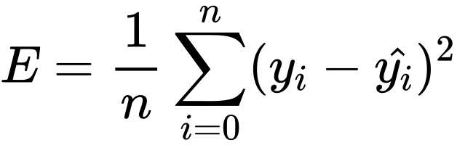
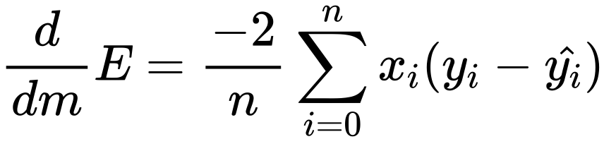
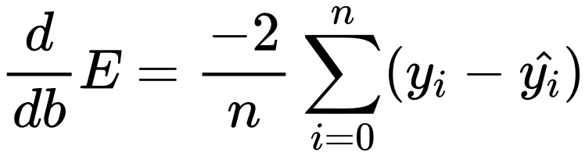
Gradient Descent for Linear Regression
For a simple linear regression fitting to y = mx + b, let’s use the following mean of squares loss function:
The derivative with respect to m is as follows:
The derivative with respect to b is:
To the right is how we use these two partial derivatives to do gradient descent on a simple linear regression.
import pandas as pd # Input data data = pd.read_csv('https://tinyurl.com/yaxgfjzt', header=None) X = data.iloc[:, 0] Y = data.iloc[:, 1] # Building the model m = 0.0 b = 0.0 L = .00001 # The learning Rate epochs = 1000000 # The number of iterations to perform gradient descent n = float(len(X)) # Number of elements in X # Performing Gradient Descent for i in range(epochs): Y_pred = m * X + b # The current predicted value of Y D_m = (-2 / n) * sum(X * (Y - Y_pred)) # d/dm derivative of loss function D_b = (-2 / n) * sum(Y - Y_pred) # d/dc derivative of loss function m = m - L * D_m # Update m b = b - L * D_b # Update b print(m, b) # 1.786000956883716 -16.422581112886167
Notes:
E = \frac{1}{n}\sum_{i=0}^n (y_i -\hat{y_i})^2
\frac{d}{dm}E = \frac{-2}{n} \sum_{i=0}^n x_i (y_i - \hat{y_i})
\frac{d}{db}E = \frac{-2}{n} \sum_{i=0}^n (y_i - \hat{y_i})

Slide 35
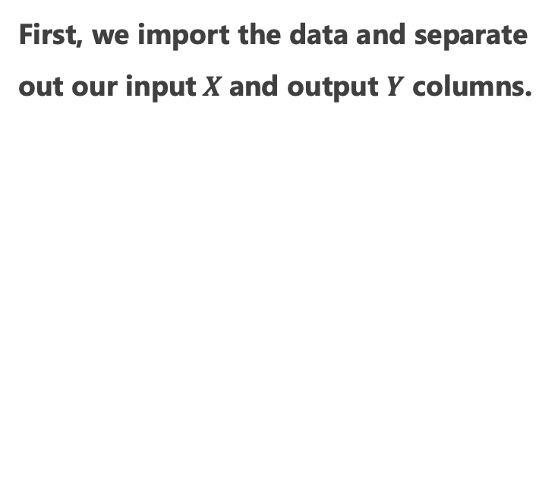
Let’s Walk Through This…
First, we import the data and separate out our input$X$and output $Y$ columns.
import pandas as pd # Input data data = pd.read_csv('https://tinyurl.com/yaxgfjzt', header=None) X = data.iloc[:, 0] Y = data.iloc[:, 1] # Building the model m = 0.0 b = 0.0 L = .00001 # The learning Rate epochs = 1000000 # The number of iterations to perform gradient descent n = float(len(X)) # Number of elements in X # Performing Gradient Descent for i in range(epochs): Y_pred = m * X + b # The current predicted value of Y D_m = (-2 / n) * sum(X * (Y - Y_pred)) # d/dm derivative of loss function D_b = (-2 / n) * sum(Y - Y_pred) # d/dc derivative of loss function m = m - L * D_m # Update m b = b - L * D_b # Update b print(m, b) # 1.786000956883716 -16.422581112886167

Slide 36
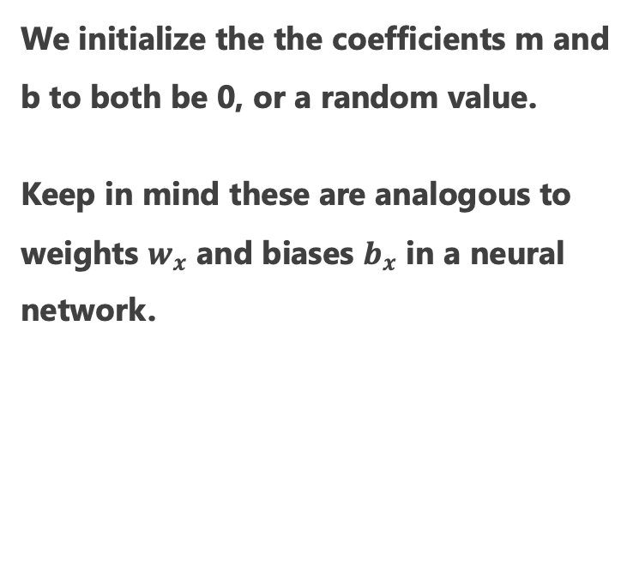
Let’s Walk Through This…
We initialize the the coefficients m and b to both be 0, or a random value.
Keep in mind these are analogous to weights $w_{x}$ and biases $b_{x}$ in a neural network.
import pandas as pd # Input data data = pd.read_csv('https://tinyurl.com/yaxgfjzt', header=None) X = data.iloc[:, 0] Y = data.iloc[:, 1] # Building the model m = 0.0 b = 0.0 L = .00001 # The learning Rate epochs = 1000000 # The number of iterations to perform gradient descent n = float(len(X)) # Number of elements in X # Performing Gradient Descent for i in range(epochs): Y_pred = m * X + b # The current predicted value of Y D_m = (-2 / n) * sum(X * (Y - Y_pred)) # d/dm derivative of loss function D_b = (-2 / n) * sum(Y - Y_pred) # d/dc derivative of loss function m = m - L * D_m # Update m b = b - L * D_b # Update b print(m, b) # 1.786000956883716 -16.422581112886167

Slide 37
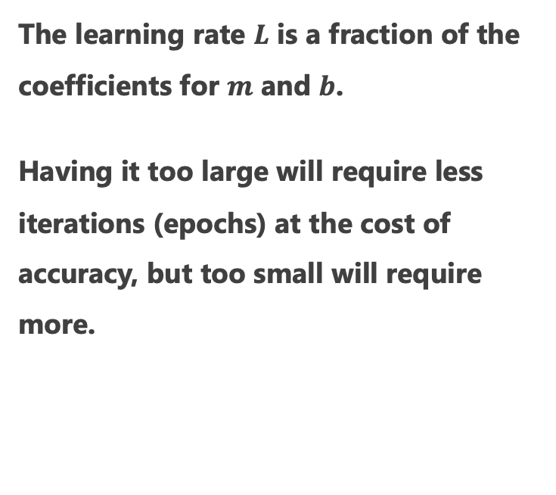
Let’s Walk Through This…
The learning rate $L$ is a fraction of the coefficients for $m$ and $b$.
Having it too large will require less iterations (epochs) at the cost of accuracy, but too small will require more.
import pandas as pd # Input data data = pd.read_csv('https://tinyurl.com/yaxgfjzt', header=None) X = data.iloc[:, 0] Y = data.iloc[:, 1] # Building the model m = 0.0 b = 0.0 L = .00001 # The learning Rate epochs = 1000000 # The number of iterations to perform gradient descent n = float(len(X)) # Number of elements in X # Performing Gradient Descent for i in range(epochs): Y_pred = m * X + b # The current predicted value of Y D_m = (-2 / n) * sum(X * (Y - Y_pred)) # d/dm derivative of loss function D_b = (-2 / n) * sum(Y - Y_pred) # d/dc derivative of loss function m = m - L * D_m # Update m b = b - L * D_b # Update b print(m, b) # 1.786000956883716 -16.422581112886167

Slide 38
Let’s Walk Through This…
Finally, the gradient descent is performed based on the two derivatives with respect to m and b against the loss function.
We subtract a fraction of the slope of each from m and b, until the loss does not improve anymore.
import pandas as pd # Input data data = pd.read_csv('https://tinyurl.com/yaxgfjzt', header=None) X = data.iloc[:, 0] Y = data.iloc[:, 1] # Building the model m = 0.0 b = 0.0 L = .00001 # The learning Rate epochs = 1000000 # The number of iterations to perform gradient descent n = float(len(X)) # Number of elements in X # Performing Gradient Descent for i in range(epochs): Y_pred = m * X + b # The current predicted value of Y D_m = (-2 / n) * sum(X * (Y - Y_pred)) # d/dm derivative of loss function D_b = (-2 / n) * sum(Y - Y_pred) # d/dc derivative of loss function m = m - L * D_m # Update m b = b - L * D_b # Update b print(m, b) # 1.786000956883716 -16.422581112886167

Slide 39
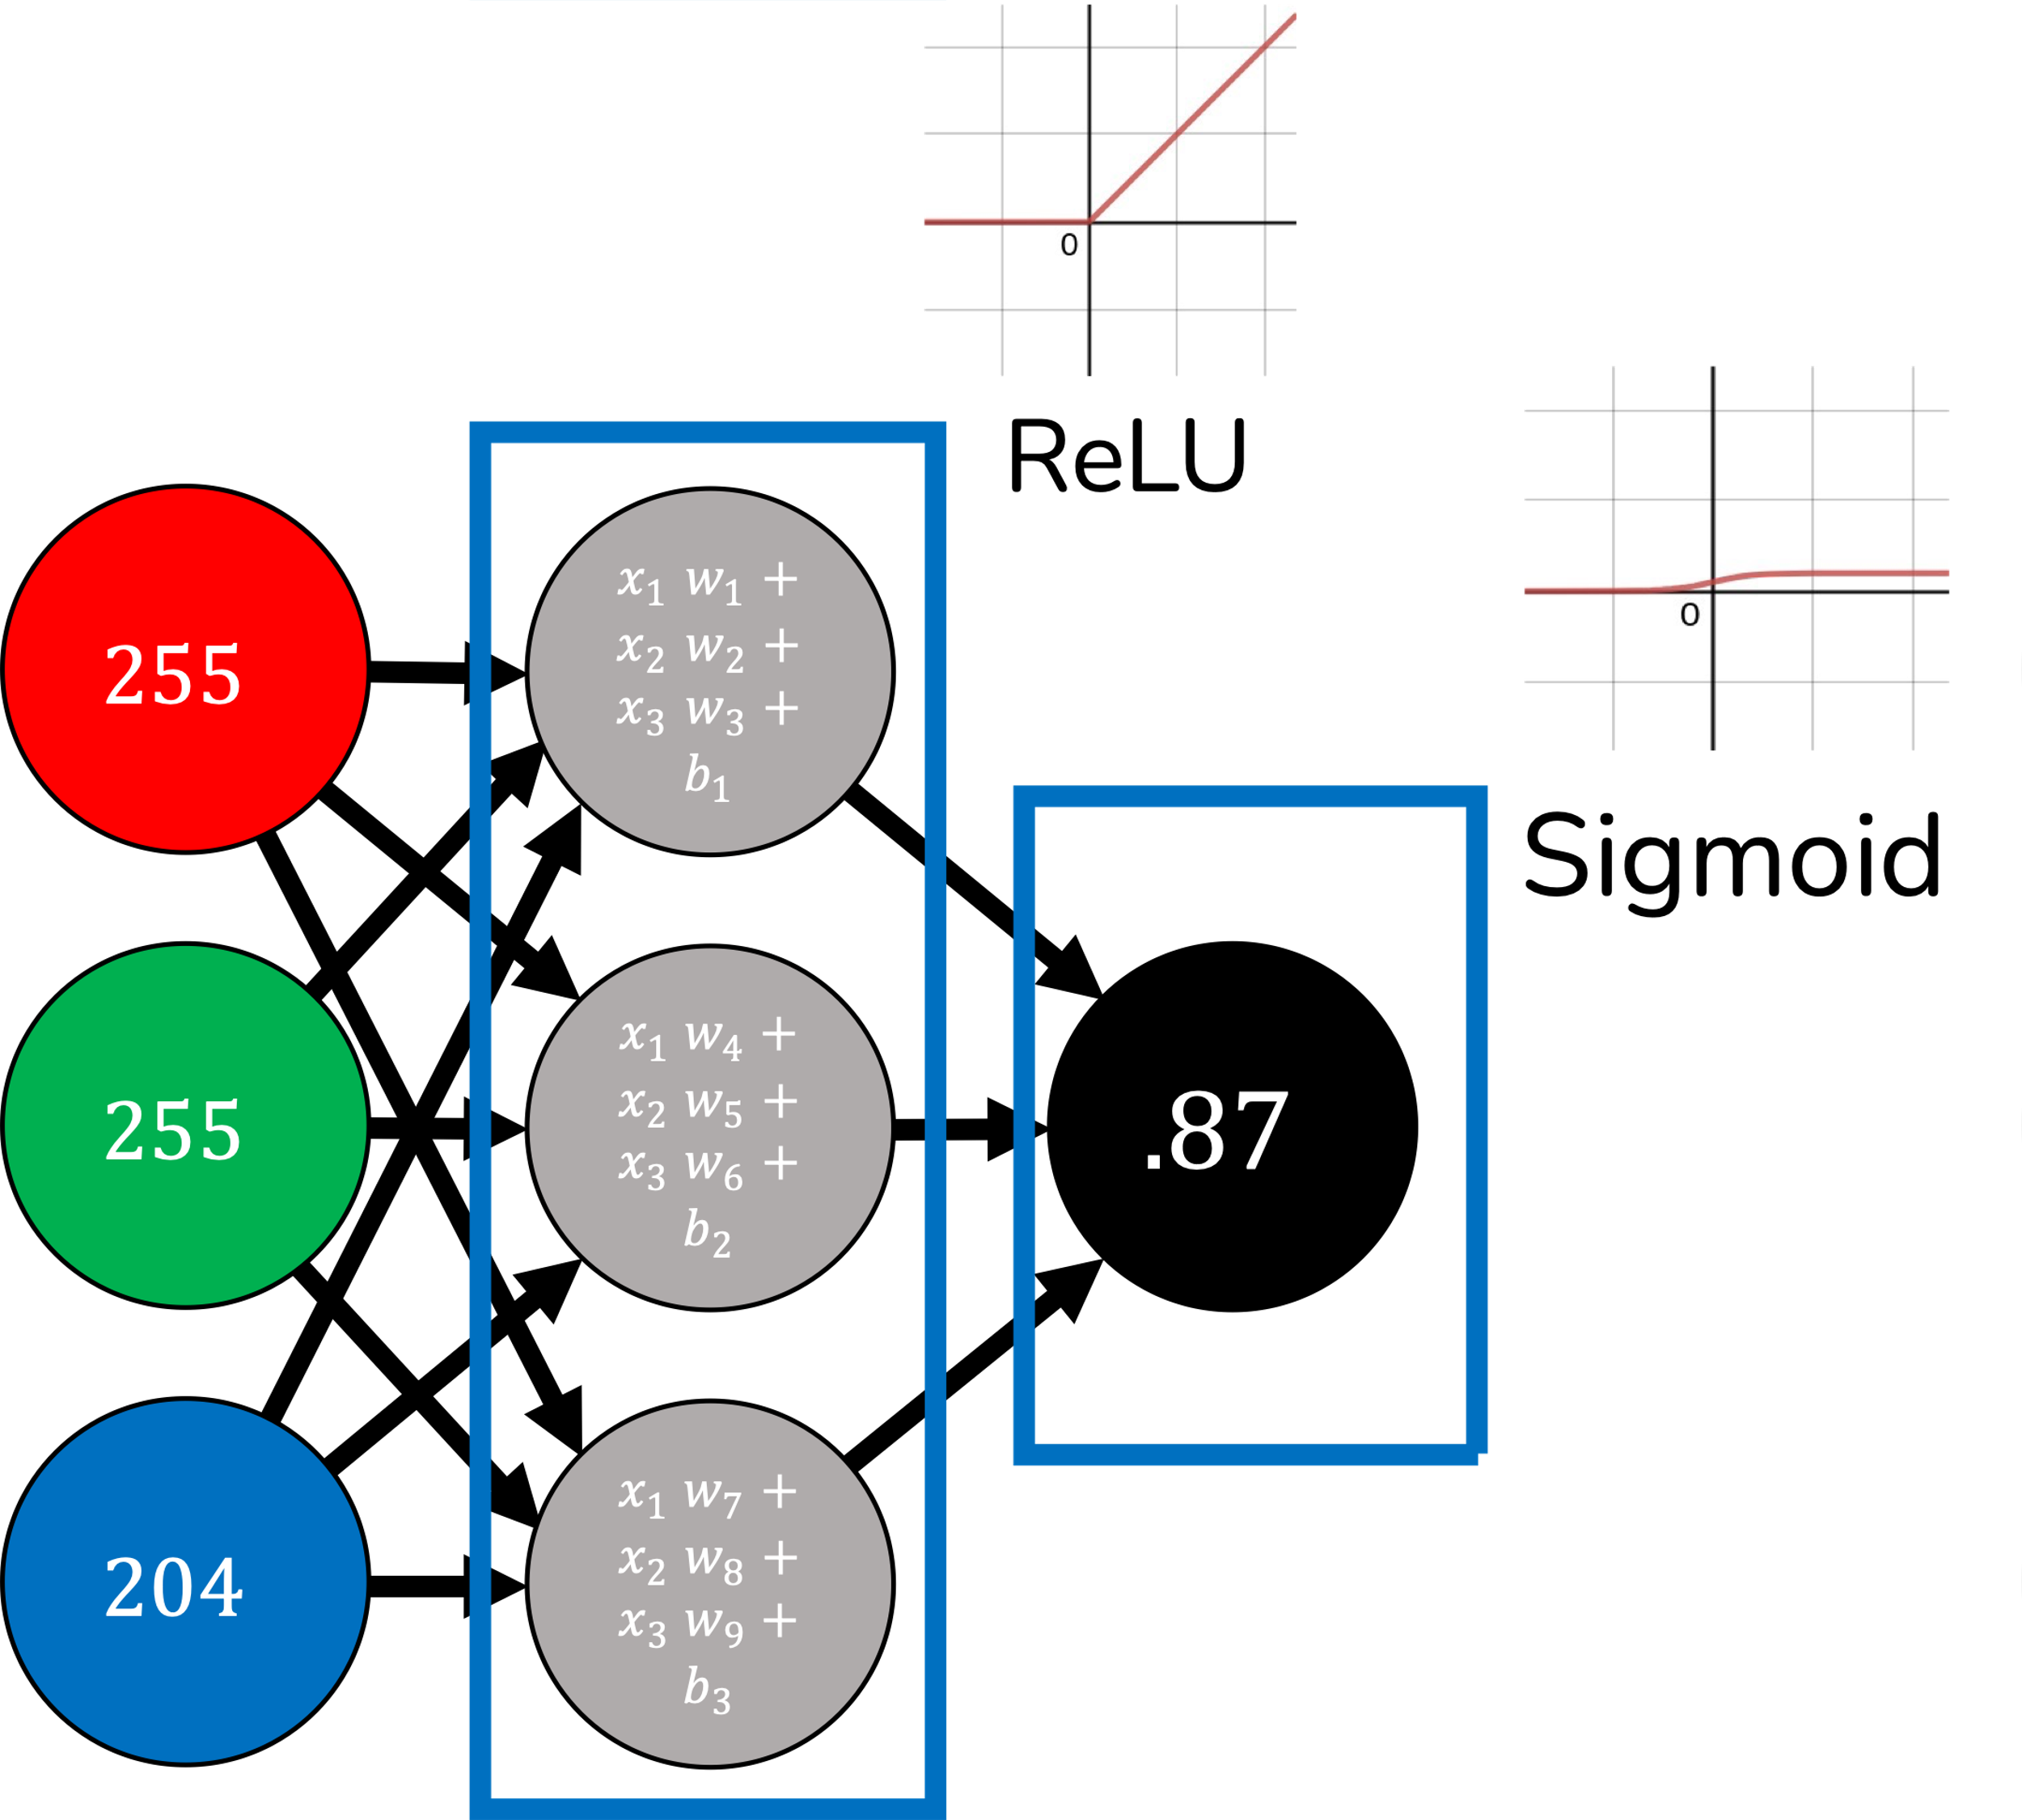
Great! How Do We Extend this to a Neural Network?
A neural network can roughly use gradient descent the same way as a linear regression.
However, there are some complications like untangling the weights and biases from the layers (we will use the chain rule).
The first issue to address is the non-convex nature of neural networks and their computational demands… which brings us to discuss stochastic gradient descent.

Slide 40
Loss Function
Weight/Bias Configurations

Slide 41
LOCAL MINIMUM
Loss Function
GLOBAL MINIMUM
Weight/Bias Configurations

Slide 42
Loss Function
Weight/Bias Configurations

Slide 43
Loss Function
Weight/Bias Configurations

Slide 44
Loss Function
Greedy algorithm gets stuck
Weight/Bias Configurations

Slide 45
Loss Function
We really want to be here
Weight/Bias Configurations

Slide 46
Loss Function
Or even here
Weight/Bias Configurations

Slide 47
How do we escape?
Loss Function
Weight/Bias Configurations

Slide 48
Make me slightly less greedy!
Loss Function
Weight/Bias Configurations

Slide 49
Occasionally allow a marginally inferior move...
Loss Function
Weight/Bias Configurations

Slide 50
Loss Function
To find superior solutions!
Weight/Bias Configurations

Slide 51
To find superior solutions!
Loss Function
Weight/Bias Configurations

Slide 52
When we have many local minima/maxima, it is because this problem is non-convex
Loss Function
Weight/Bias Configurations

Slide 53
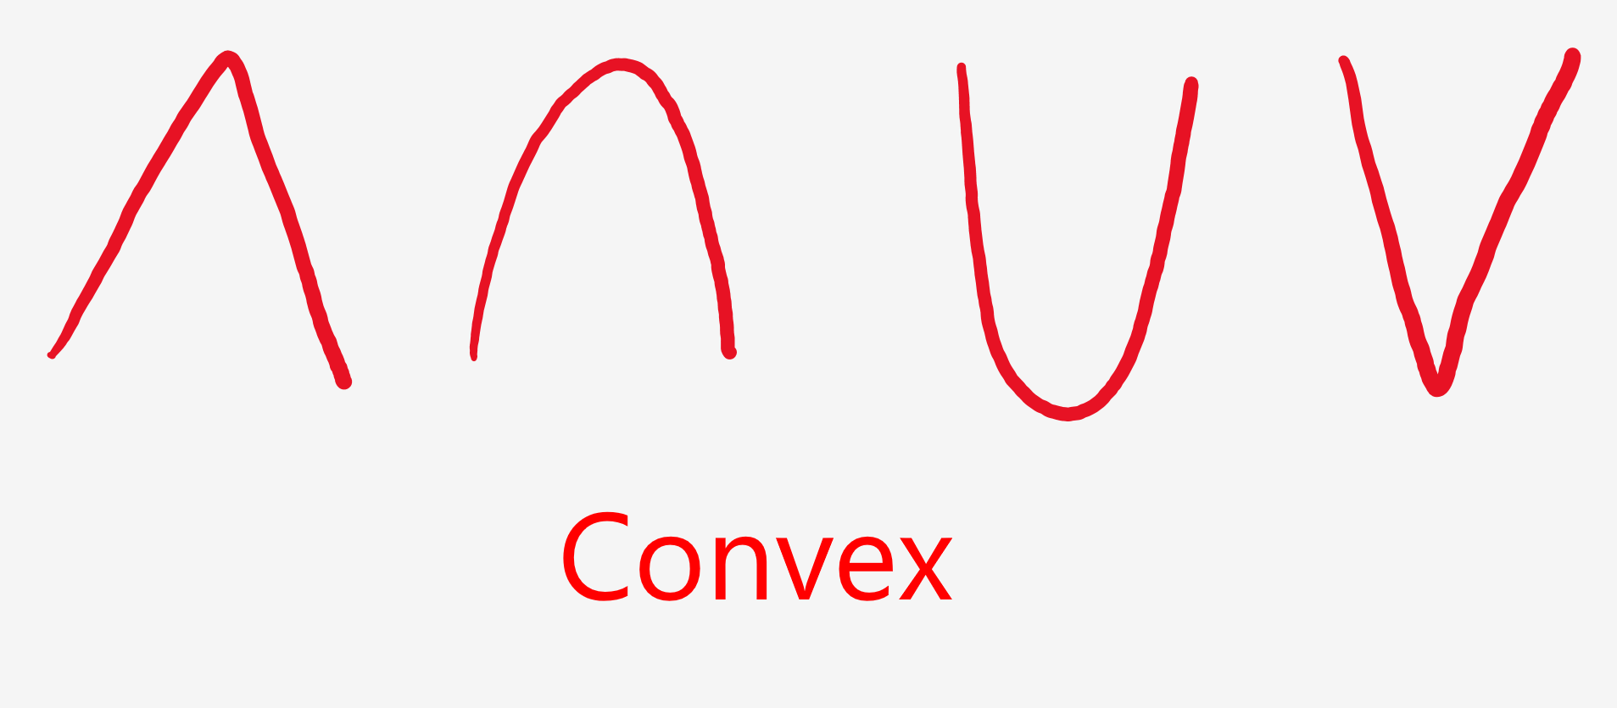
Convex versus Non-Convex

Slide 54
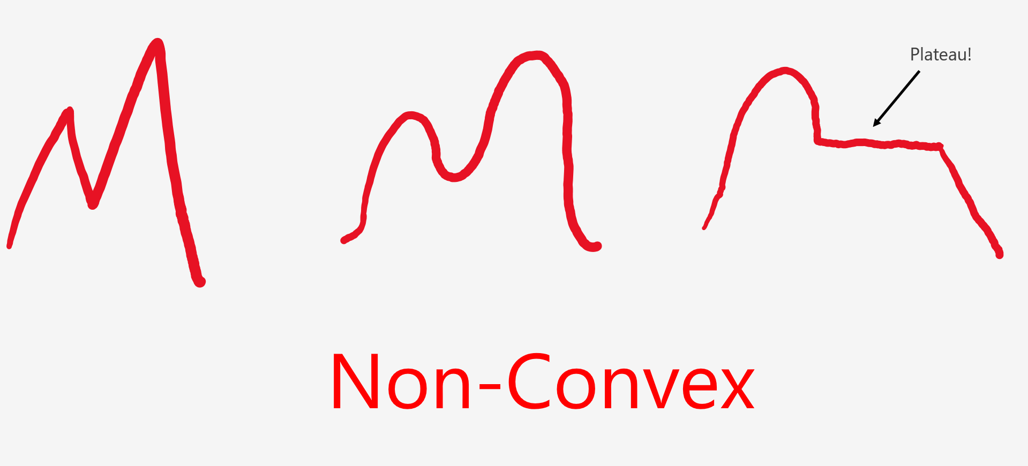
Convex versus Non-Convex

Slide 55
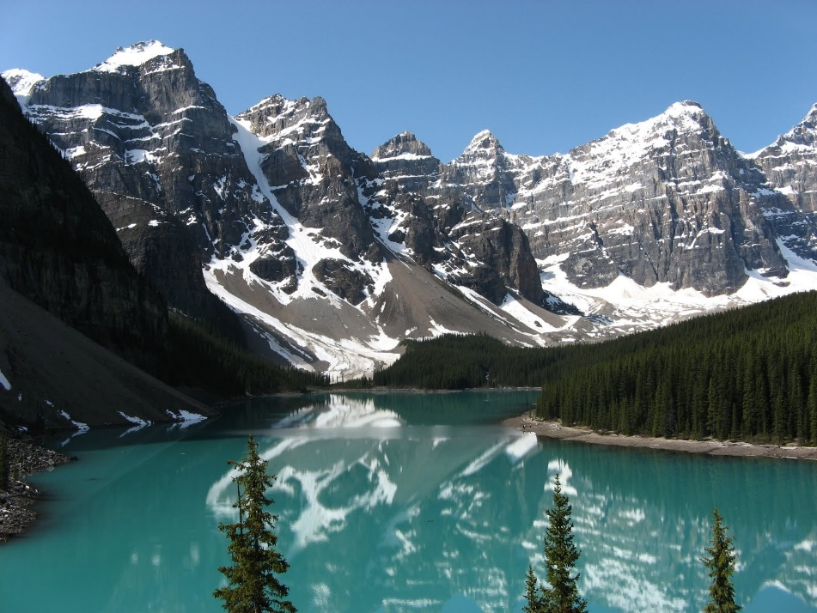
Convex versus Non-Convex
If all problems were convex, optimization and machine learning would be easy because there would only be one global minimum or maximum.
Unfortunately, this is often not the case for many problems (especially neural networks/deep learning), and it is easy to get stuck in a local minimum or maximum.
Therefore, randomized searches like stochastic gradient descent are a common solution to finding a better minimum/maximum when many exist.

Slide 56
Stochastic Gradient Descent
In practice, it can be expensive to process an entire data set at every iteration during training with gradient descent.
Fitting the entire training data on each iteration is also more likely to get stuck in a local minimum/maximum.
Simpler models like linear regression and logistic regression are convex, while neural networks/deep learning are non-convex.
Therefore, stochastic gradient descent is how gradient descent is often used in practice (especially neural networks/deep learning), as it randomly selects only a few training samples at every iteration, adding some randomized benefits to find a better local minimum.
import pandas as pd import numpy as np # Input data data = pd.read_csv('https://bit.ly/3n1FKgE', header=0) X = data.iloc[:, 0].values Y = data.iloc[:, 1].values n = data.shape[0] # rows # Building the model m = 0.0 b = 0.0 sample_size = 10 # sample size L = .00001 # The learning Rate epochs = 1000000 # The number of iterations to perform gradient descent # Performing Stochastic Gradient Descent for i in range(epochs): idx = np.random.choice(n, sample_size, replace=False) x_sample = X[idx] y_sample = Y[idx] Y_pred = m * x_sample + b # The current predicted value of Y D_m = (-2 / sample_size) * sum(x_sample * (y_sample - Y_pred)) # d/dm derivative of loss function D_b = (-2 / sample_size) * sum(y_sample - Y_pred) # d/dc derivative of loss function m = m - L * D_m # Update m b = b - L * D_b # Update b # print progress if i % 10000 == 0: print(i, m, b) print(m, b)

Slide 57
Stochastic Gradient Descent
You are more likely to perform stochastic gradient descent, which will train on only one sample of the dataset on each iteration.
In mini-batch gradient descent, multiple samples of the dataset are used (e.g., 10 or 100 data points) on each iteration (shown to the right).
Notice how we only randomly sample part of the data and ignore the rest on each iteration.
import pandas as pd import numpy as np # Input data data = pd.read_csv('https://bit.ly/3n1FKgE', header=0) X = data.iloc[:, 0].values Y = data.iloc[:, 1].values n = data.shape[0] # rows # Building the model m = 0.0 b = 0.0 sample_size = 10 # sample size L = .00001 # The learning Rate epochs = 1000000 # The number of iterations to perform gradient descent # Performing Stochastic Gradient Descent for i in range(epochs): idx = np.random.choice(n, sample_size, replace=False) x_sample = X[idx] y_sample = Y[idx] Y_pred = m * x_sample + b # The current predicted value of Y D_m = (-2 / sample_size) * sum(x_sample * (y_sample - Y_pred)) # d/dm derivative of loss function D_b = (-2 / sample_size) * sum(y_sample - Y_pred) # d/dc derivative of loss function m = m - L * D_m # Update m b = b - L * D_b # Update b # print progress if i % 10000 == 0: print(i, m, b) print(m, b)

Slide 58
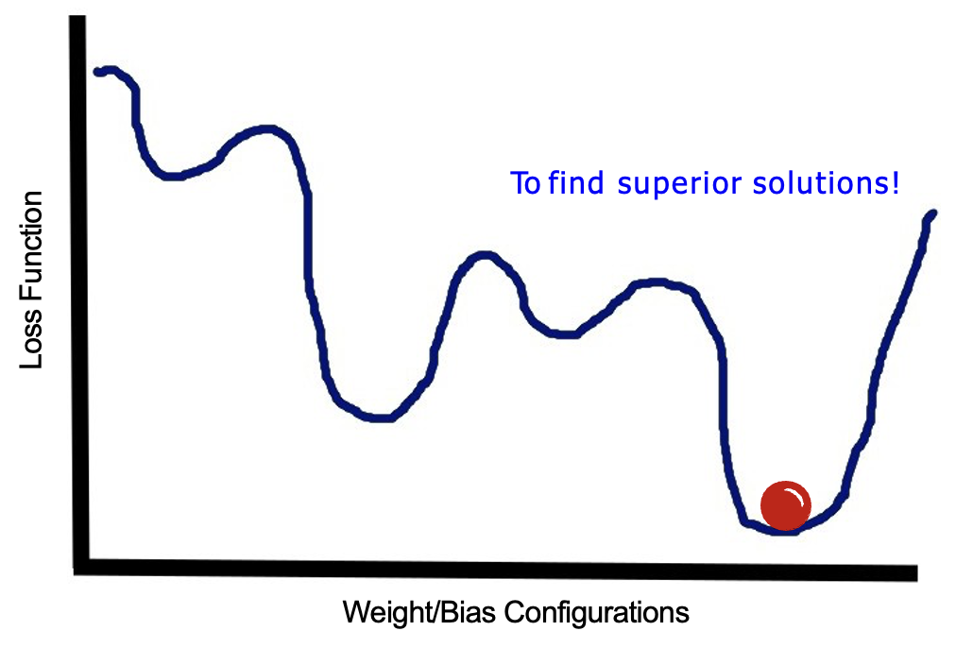
Why Stochastic Gradient Descent?
Why use only part of the data on each iteration?
It reduces computation significantly, as each iteration does not have to traverse the entire training dataset but only part of it.
It prevents getting stuck in the first local minimum found and finds a better fit.
It reduces overfitting, as exposing the training algorithm to only part of the data on each iteration keeps changing the loss landscape so it does not settle in the global minimum (overfitting is discussed later).

Slide 59
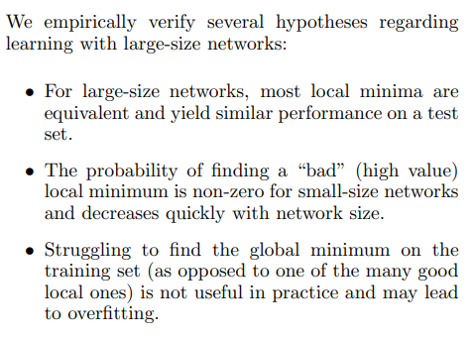
Is Finding the Global Minimum the Objective?
Pulling back, is finding the loss global minimum the focal objective?
For pure optimization problems (e.g. traveling salesman), yes! We want to minimize or maximize an objective.
But for machine learning, the global minimum is usually not useful in practice and may cause overfitting.
In machine learning (especially neural networks), we often settle for a “good enough” local minima that performs well with our testing data.
We will cover neural networks and machine learning evaluation later.
Anna Choromanska et al. suggest that neural networks do not warrant finding the global minimum, but rather an acceptable local minimum.
https://arxiv.org/pdf/1412.0233v3.pdf
[1] Choromanska, Anna & Henaff, Mikael & Mathieu, Michael & Ben Arous, Gerard & Lecun, Yann. (2014). The Loss Surface of Multilayer Networks.

Slide 60
EXERCISE 3

Slide 61
Section VI Backpropagation

Slide 62

The Chain Rule
To untangle the weights and biases nested in layers on the neural networks, we are going to have to leverage the chain rule.
The chain rule is a powerful tool that separates derivatives in nested functions.
Without the chain rule, you would tear your hair out trying to figure how a given weight or bias affects the cost function of our your neural network!

Slide 63
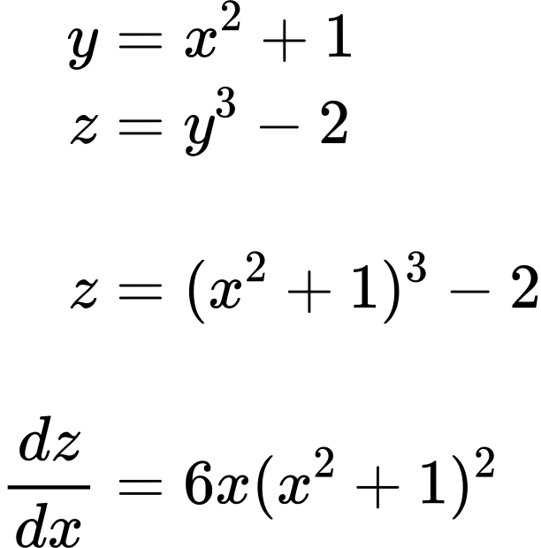
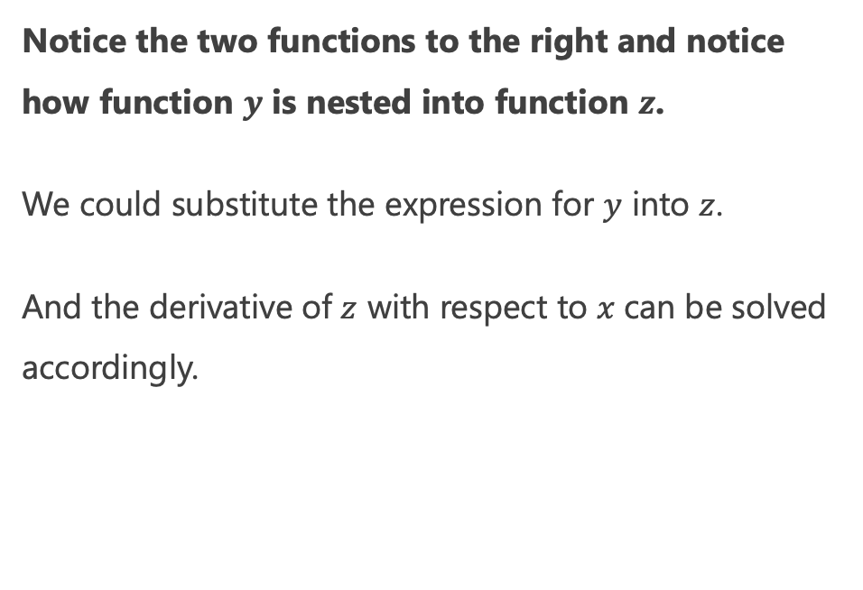
Chain Rule: A Simple Example
Notice the two functions to the right and notice how function $y$ is nested into function $z$.
We could substitute the expression for $y$ into $z$.
And the derivative of $z$ with respect to $x$can be solved accordingly.
from sympy import *
z = (x**2 + 1)**3 - 2
dz_dx = diff(z, x)
print(dz_dx)
# 6*x*(x**2 + 1)**2
Notes:
\begin{aligned}
y &= x^2 + 1 \\
z &= y^3 - 2 \\
\\
z &= (x^2 +1) ^3 - 2 \\
\\
\frac{dz}{dx} &= 6x(x^2 + 1)^2
\end{aligned}

Slide 64
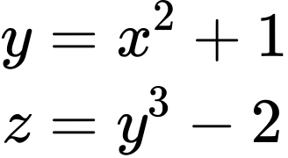
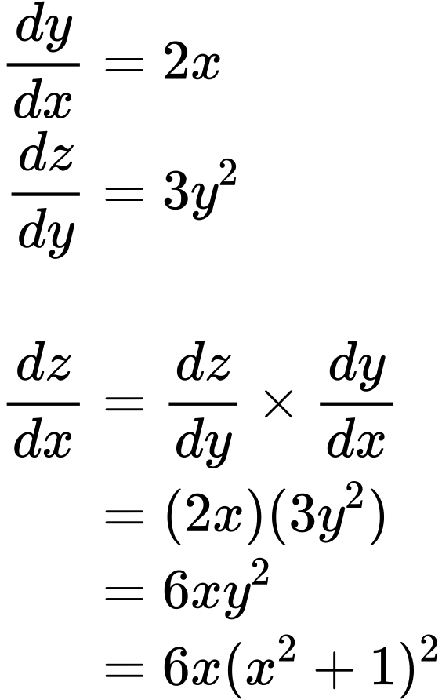
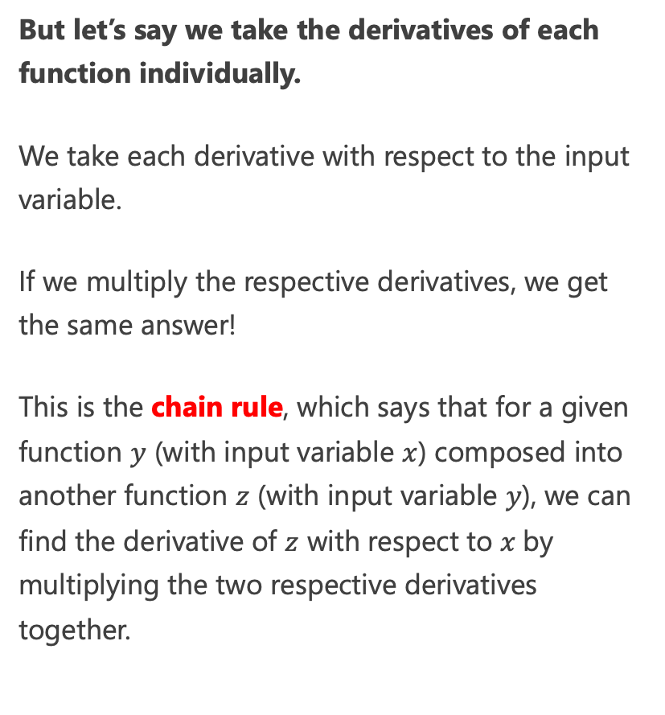
Chain Rule: A Simple Example
But let’s say we take the derivatives of each function individually.
We take each derivative with respect to the input variable.
If we multiply the respective derivatives, we get the same answer!
This is the chain rule, which says that for a given function $y$ (with input variable $x$) composed into another function $z$ (with input variable $y$), we can find the derivative of $z$ with respect to $x$by multiplying the two respective derivatives together.
Notes:
\begin{aligned}
y &= x^2 + 1 \\
z &= y^3 - 2 \\
\\
\frac{dy}{dx} &= 2x \\
\frac{dz}{dy} &= 3y^2 \\
\\
\frac{dz}{dx} &= \frac{dz}{dy} \times \frac{dy}{dx} \\
&= (2x)(3y^2) \\
&= 6xy^2 \\
&= 6x(x^2 + 1)^2
\end{aligned}

Slide 65
Chain Rule: A Simple Example
Compare the two processes side-by-side and observe they both give the same answer!
Derive individually then multiply
Substitute then derive
Notes:
\begin{aligned}
y &= x^2 + 1 \\
z &= y^3 - 2 \\
\\
\frac{dy}{dx} &= 2x \\
\frac{dz}{dy} &= 3y^2 \\
\\
\frac{dz}{dx} &= \frac{dz}{dy} \times \frac{dy}{dx} \\
&= (2x)(3y^2) \\
&= 6xy^2 \\
&= 6x(x^2 + 1)^2
\end{aligned}

Slide 66
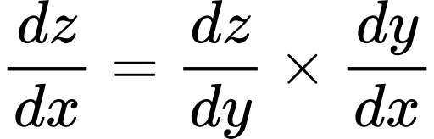
Using Chain Rule for Neural Networks
Why is the chain rule a big deal for neural networks and deep learning?
The chain rule is a key part of training a neural network with the proper weights and biases.
Rather than untangle the derivative of each node in a nested onion fashion, we can multiply the derivatives across each node instead, which is mathematically a lot easier.
Notes:
\frac{dC}{dW_2} = \frac{dZ_2}{dW_2} \times \frac{dA_2}{dZ_2} \times \frac{dC}{dA_2}

Slide 67
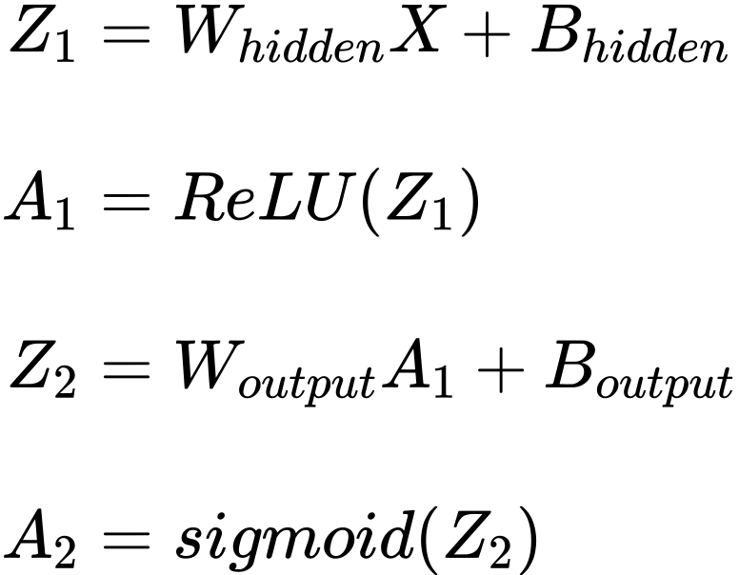
Forward Propagation Review
Recall when we learned forward propagation, we expressed the operations of each layer of the neural network.
Z₁ and Z₂ are are the raw outputs of each layer, and A₁ and A2 are the activated outputs.
relu = lambda x: np.maximum(x, 0)
logistic = lambda x: 1 / (1 + np.exp(-x))
def forward_prop(X):
Z1 = w_hidden @ X + b_hidden
A1 = relu(Z1)
Z2 = w_output @ A1 + b_output
A2 = logistic(Z2)
return Z1, A1, Z2, A2

Slide 68



Using Chain Rule for Neural Networks
Let’s define a cost function $C$ for our neural network, which will square the differences between the predicted outputs $A2$ and actual outputs $Y$ in our training data.
Notes:
\begin{align}
Z_1 &= W_{hidden}X + B_{hidden} \\
\\
A_1 &= ReLU(Z_1) \\
\\
Z_2 &= W_{output}A_1 + B_{output} \\
\\
A_2 &= sigmoid(Z_2) \\
\\
C &= (A_2 - Y)^2
\end{align}

Slide 69

Using Chain Rule for Neural Networks
If we want to measure how a given weight W₂ affects the cost function C, we need to find that derivative using the chain rule.
Notes:
\begin{align}
\frac{dC}{dW_2} &= \frac{dZ_2}{dW_2} \times \frac{dA_2}{dZ_2} \times \frac{dC}{dA_2} \\
\\
\frac{dC}{dW_2} &= \frac{dZ_2}{dW_2} \times \frac{\cancel{dA_2}}{dZ_2} \times \frac{dC}{\cancel{dA_2}} \\
\\
\frac{dC}{dW_2} &= \frac{\cancel{dZ_2}}{dW_2} \times \frac{\cancel{dA_2}}{\cancel{dZ_2}} \times \frac{dC}{\cancel{dA_2}}
\end{align}

Slide 70

Using Chain Rule for Neural Networks
If we want to measure how a given weight W₂ affects the cost function C, we need to find that derivative using the chain rule.
Notes:
\begin{align}
\frac{dC}{dW_2} &= \frac{dZ_2}{dW_2} \times \frac{dA_2}{dZ_2} \times \frac{dC}{dA_2} \\
\\
\frac{dC}{dW_2} &= \frac{dZ_2}{dW_2} \times \frac{\cancel{dA_2}}{dZ_2} \times \frac{dC}{\cancel{dA_2}} \\
\\
\frac{dC}{dW_2} &= \frac{\cancel{dZ_2}}{dW_2} \times \frac{\cancel{dA_2}}{\cancel{dZ_2}} \times \frac{dC}{\cancel{dA_2}}
\end{align}

Slide 71

Using Chain Rule for Neural Networks
If we want to measure how a given weight W₂ affects the cost function C, we need to find that derivative using the chain rule.
Note the diagonal cancellation pattern above to get that derivative.
This pattern can help us determine what derivatives we need.
Notes:
\begin{align}
\frac{dC}{dW_2} &= \frac{dZ_2}{dW_2} \times \frac{dA_2}{dZ_2} \times \frac{dC}{dA_2} \\
\\
\frac{dC}{dW_2} &= \frac{dZ_2}{dW_2} \times \frac{\cancel{dA_2}}{dZ_2} \times \frac{dC}{\cancel{dA_2}} \\
\\
\frac{dC}{dW_2} &= \frac{\cancel{dZ_2}}{dW_2} \times \frac{\cancel{dA_2}}{\cancel{dZ_2}} \times \frac{dC}{\cancel{dA_2}}
\end{align}

Slide 72

Untangling a Derivative
Let’s find this derivative highlighted in red first, specifically finding the derivative of this function:
Using SymPy as shown to the right, we get this derivative.
Next let’s untangle that derivative with A₂.
from sympy import *
A2, y = symbols('A2 Y')
C = (A2 - Y)**2
dC_dA2 = diff(C, A2)
print(dC_dA2) # 2*A2 - 2*Y
Notes:
\frac{dC}{dA_2} = 2A_2 - 2Y

Slide 73


Untangling a Derivative
Let’s move on to the next derivative, which uses the sigmoid activation function.
Using SymPy as shown to the right, we get this derivative.
Next let’s untangle that derivative with Z₂.
from sympy import *
Z2 = symbols('Z2')
logistic = lambda x: 1 / (1 + exp(-x))
A2 = logistic(Z2)
dA2_dZ2 = diff(A2, Z2)
print(dA2_dZ2)
# exp(-Z2)/(1 + exp(-Z2))**2
Notes:
A_2 = \frac{1}{1 + e^{-Z_2}}
\frac{dA_2}{dZ_2} = \frac{e^{-Z_2}}{(1 + e^{-Z_2})^2}

Slide 74


Untangling a Derivative
Recall that Z₂ is a simple linear function, so this is going to be easy.
A derivative will eliminate the slope and bias leaving A₁.
And now we have all three derivatives, next we multiply them!
from sympy import *
A1, W2, B2 = symbols('A1, W2, B2')
Z2 = W2*A1 + B2
dZ2_dW2 = diff(Z2, W2)
print(dZ2_dW2) # A1
Notes:
\frac{dC}{dA_2} = 2A_2 - 2Y
\frac{dA_2}{dZ_2} = \frac{e^{-Z_2}}{(1 + e^{-Z_2})^2}

Slide 75

Untangling a Derivative
Now that we have all three derivative components, we can multiply them together.
Try try not get lost in the math, and always remember what we were trying to accomplish: find the derivative of a weight in the output layer with respect to the cost function.
We can now use SymPy to calculate the rest of the derivatives and calculate how each weight and bias affects the cost function.
Notes:
\begin{align}
\frac{dC}{dW_2} &= \frac{dZ_2}{dW_2} \times \frac{dA_2}{dZ_2} \times \frac{dC}{dA_2} \\
\\
\frac{dC}{dW_2} &= (A_1) (\frac{e^{-Z_2}}{(1 + e^{-Z_2})^2}
) (2A_2 - 2Y)
\end{align}

Slide 76

Find the Remaining Derivatives
We need to repeat this process to find the derivatives of the cost function with respect to every weight and bias.
Notes:
\begin{align}
\frac{dC}{dW_2} &= \frac{dZ_2}{dW_2} \frac{dA_2}{dZ_2} \frac{dC}{dA_2} = (A_1) (\frac{e^{-Z_2}}{(1 + e^{-Z_2})^2}
) (2A_2 - 2Y) \\
\\
\frac{dC}{dB_2} &= \frac{dZ_2}{dB_2} \frac{dA_2}{dZ_2} \frac{dC}{dA_2} = (1) (\frac{e^{-Z_2}}{(1 + e^{-Z_2})^2}
) (2A_2 - 2Y) \\
\\
\frac{dC}{dW_1} &= \frac{dC}{dA_2} \frac{dA_2}{dZ_2} \frac{dZ_2}{dA_1} \frac{dA_1}{dZ_1} \frac{dZ_1}{dW_1} = (2A_2 - 2Y)(\frac{e^{-Z_2}}{(1 + e^{-Z_2})^2})(W_2)(Z_1 > 0)(X) \\
\\
\frac{dC}{dB_1} &= \frac{dC}{dA_2} \frac{dA_2}{dZ_2} \frac{dZ_2}{dA_1} \frac{dA_1}{dZ_1} \frac{dZ_1}{dB_1} = (2A_2 - 2Y)(\frac{e^{-Z_2}}{(1 + e^{-Z_2})^2})(W_2)(Z_1 > 0)(1)
\end{align}

Slide 77
All Neural Network Derivative Components
from sympy import *
W1, W2, B1, B2, A1, A2, Z1, Z2, X, Y = \
symbols('W1 W2 B1 B2 A1 A2 Z1 Z2 X Y')
# Calculate derivative of cost function with respect to A2
C = (A2 - Y)**2
dC_dA2 = diff(C, A2)
print("dC_dA2 = ", dC_dA2) # 2*A2 - 2*Y
# Calculate derivative of A2 with respect to Z2
logistic = lambda x: 1 / (1 + exp(-x))
_A2 = logistic(Z2)
dA2_dZ2 = diff(_A2, Z2)
print("dA2_dZ2 = ", dA2_dZ2) # exp(-Z2)/(1 + exp(-Z2))**2
# Calculate derivative of Z2 with respect to A1
_Z2 = A1*W2 + B2
dZ2_dA1 = diff(_Z2, A1)
print("dZ2_dA1 = ", dZ2_dA1) # W2
# Calculate derivative of Z2 with respect to W2
dZ2_dW2 = diff(_Z2, W2)
print("dZ2_dW2 = ", dZ2_dW2) # A1
# Calculate derivative of Z2 with respect to B2
dZ2_dB2 = diff(_Z2, B2)
print("dZ2_dB2 = ", dZ2_dB2) # 1
# Calculate derivative of A1 with respect to Z1
relu = lambda x: Max(x, 0)
_A1 = relu(Z1)
# Slope is 1 if positive, 0 if negative d_relu = lambda x: x > 0 dA1_dZ1 = d_relu(Z1)
print("dA1_dZ1 = ", dA1_dZ1) # Z1 > 0
# Calculate derivative of Z1 with respect to W1
_Z1 = X*W1 + B1
dZ1_dW1 = diff(_Z1, W1)
print("dZ1_dW1 = ", dZ1_dW1) # X
# Calculate derivative of Z1 with respect to B1
dZ1_dB1 = diff(_Z1, B1)
print("dZ1_dB1 = ", dZ1_dB1) # 1

Slide 78
All Neural Network Derivative Components
Notes:
\begin{align}
\frac{dC}{dW_2} &= \frac{dZ_2}{dW_2} \frac{dA_2}{dZ_2} \frac{dC}{dA_2} = (A_1) (\frac{e^{-Z_2}}{(1 + e^{-Z_2})^2}
) (2A_2 - 2Y) \\
\\
\frac{dC}{dB_2} &= \frac{dZ_2}{dB_2} \frac{dA_2}{dZ_2} \frac{dC}{dA_2} = (1) (\frac{e^{-Z_2}}{(1 + e^{-Z_2})^2}
) (2A_2 - 2Y) \\
\\
\frac{dC}{dW_1} &= \frac{dC}{dA_2} \frac{dA_2}{dZ_2} \frac{dZ_2}{dA_1} \frac{dA_1}{dZ_1} \frac{dZ_1}{dW_1} = (2A_2 - 2Y)(\frac{e^{-Z_2}}{(1 + e^{-Z_2})^2})(W_2)(Z_1 > 0)(X) \\
\\
\frac{dC}{dB_1} &= \frac{dC}{dA_2} \frac{dA_2}{dZ_2} \frac{dZ_2}{dA_1} \frac{dA_1}{dZ_1} \frac{dZ_1}{dB_1} = (2A_2 - 2Y)(\frac{e^{-Z_2}}{(1 + e^{-Z_2})^2})(W_2)(Z_1 > 0)(1)
\end{align}

Slide 79
WHEW!

Slide 80

Now What? Oh Yeah, Gradient Descent
It might help to pull back and realize what we accomplished: we got the derivatives for each weight and bias value in a neural network.
We now have everything we need to perform gradient descent, or more specifically stochastic gradient descent, just like we did with a linear regression.
On every iteration, we take a fraction of the gradient/slope for each weight and bias parameter, and subtract it accordingly.

Slide 81
Now What? Oh Yeah, Gradient Descent
We are now ready to integrate the chain rule to perform stochastic gradient descent.
To keep things simple, we are going to sample only one training record on every iteration.
Batch and mini-batch gradient descent are commonly used in neural networks and deep learning, but there’s enough linear algebra and calculus to juggle just one sample per iteration.

Slide 82
Backward Propagation and Stochastic Gradient Descent
# returns slopes for weights and biases
# using chain rule
def backward_prop(Z1, A1, Z2, A2, X, Y):
dC_dA2 = 2 * A2 - 2 * Y
dA2_dZ2 = d_logistic(Z2)
dZ2_dA1 = w_output
dZ2_dW2 = A1
dZ2_dB2 = 1
dA1_dZ1 = d_relu(Z1)
dZ1_dW1 = X
dZ1_dB1 = 1
dC_dW2 = dC_dA2 @ dA2_dZ2 @ dZ2_dW2.T
dC_dB2 = dC_dA2 @ dA2_dZ2 * dZ2_dB2
dC_dA1 = dC_dA2 @ dA2_dZ2 @ dZ2_dA1
dC_dW1 = dC_dA1 @ dA1_dZ1 @ dZ1_dW1.T
dC_dB1 = dC_dA1 @ dA1_dZ1 * dZ1_dB1
return dC_dW1, dC_dB1, dC_dW2, dC_dB2
# Execute stochastic gradient descent
for i in range(100_000):
# randomly select one of the training data
idx = np.random.choice(n, 1, replace=False)
X_sample = X_train[idx].transpose()
Y_sample = Y_train[idx]
# run randomly selected training data
# through neural network
Z1, A1, Z2, A2 = forward_prop(X_sample)
# distribute error through backpropagation
# and return slopes for weights and biases
dW1, dB1, dW2, dB2 = \
backward_prop(Z1, A1, Z2, A2, X_sample, Y_sample)
# update weights and biases
w_hidden -= L * dW1
b_hidden -= L * dB1
w_output -= L * dW2
b_output -= L * dB2

Slide 83
Backward Propagation and Stochastic Gradient Descent
The backward_prop() function is key here, implementing the chain rule to take the error in the output node (the squared residual), and then divide it up and distribute it backward to the output and hidden weights/biases to get the slopes with respect to each weight/bias.
We then take those slopes and nudge the weights/biases in the for loop, respectively, multiplying with the learning rate L just like we did with linear regression.
We do some matrix-vector multiplication using @ to distribute the error backward based on the slopes, and we transpose matrices and vectors when needed so the dimensions between rows and columns match up.
# returns slopes for weights and biases
# using chain rule
def backward_prop(Z1, A1, Z2, A2, X, Y):
dC_dA2 = 2 * A2 - 2 * Y
dA2_dZ2 = d_logistic(Z2)
dZ2_dA1 = w_output
dZ2_dW2 = A1
dZ2_dB2 = 1
dA1_dZ1 = d_relu(Z1)
dZ1_dW1 = X
dZ1_dB1 = 1
dC_dW2 = dC_dA2 @ dA2_dZ2 @ dZ2_dW2.T
dC_dB2 = dC_dA2 @ dA2_dZ2 * dZ2_dB2
dC_dA1 = dC_dA2 @ dA2_dZ2 @ dZ2_dA1
dC_dW1 = dC_dA1 @ dA1_dZ1 @ dZ1_dW1.T
dC_dB1 = dC_dA1 @ dA1_dZ1 * dZ1_dB1
return dC_dW1, dC_dB1, dC_dW2, dC_dB2

Slide 84
EXERCISE 4

